Slide 1
Application Delivery Fundamentals 2.0 B: Java
Spring Boot

Slide 2
Spring Boot
Goals
Provide a radically faster and widely accessible getting started experience
Be opinionated out of the box, but get out of the way quickly as requirements start to diverge from the defaults
Provide a range of non-functional features that are common to large classes of projects (e.g. embedded servers, security, metrics, health checks, externalized configuration)
Absolutely no code generation and no requirement for XML configuration

Slide 3
Spring Boot
Goals
To avoid defining more Annotation Configuration(It combined some existing Spring Framework Annotations to a simple and single Annotation)
Spring Boot avoid writing lots of import statements
To provide some defaults to quick start new projects within no time.

Slide 5
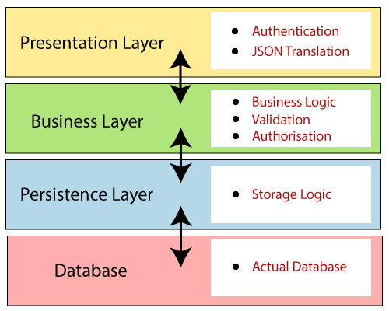
Spring Boot Architecture

Slide 6
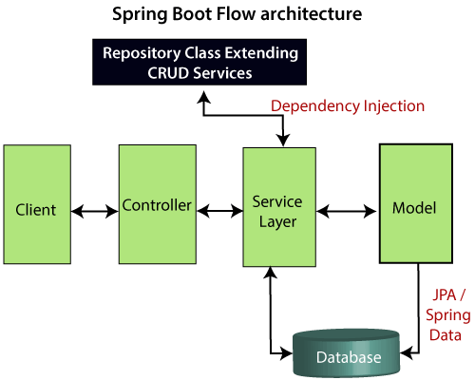
Spring boot Flow Architecture

Slide 7
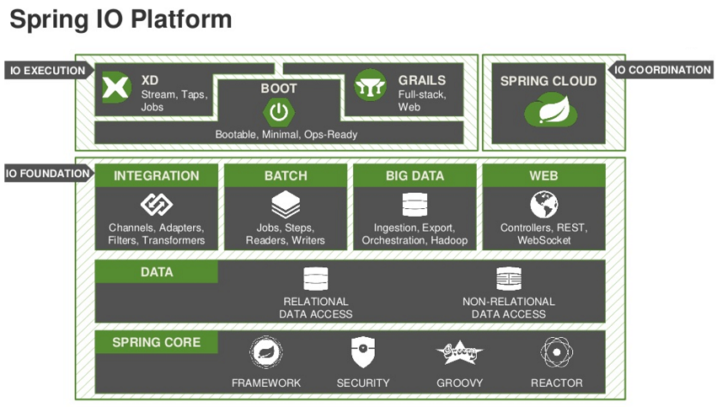
Spring IO platform

Slide 8
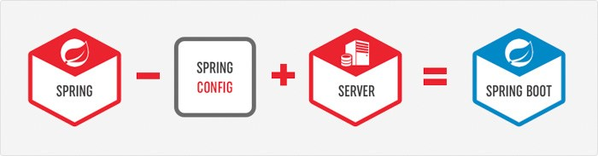
SpringBoot = a Sub-Project of SpringFramework

Slide 9
SpringBoot = a Sub-Project of SpringFramework

Slide 10
SpringBoot = a Sub-Project of SpringFramework

Slide 11
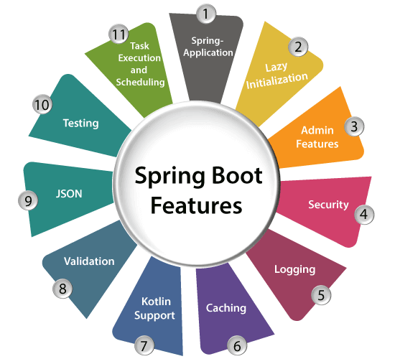
Spring boot features

Slide 13
Spring Boot Modules

Slide 14
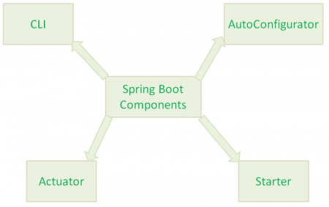
Spring Components

Slide 15
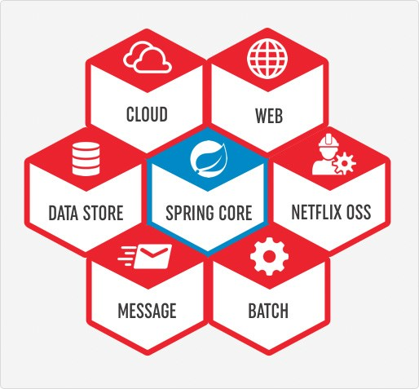
Spring Boot Starters

Slide 16
Springboot Starter
The main responsibility of Spring Boot Starter is to combine a group of common or related dependencies into single dependencies.
For instance, we would like to develop a Spring WebApplication with Tomcat WebServer.
Then we need to add the following minimal jar dependencies in your Maven’s pom.xml file or Gradle’s build.gradle file
Spring core Jar file(spring-core-xx.jar)
Spring Web Jar file(spring-web-xx.jar)
Spring Web MVC Jar file(spring-webmvc-xx.jar)
Servlet Jar file(servlet-xx.jar)

Slide 17
Springboot Starter
If we want to add some database, then we need to add database related jars like Spring JDBC jar file, Spring ORM jar files,Spring Transaction Jar file etc.
Spring JDBC Jar file(spring-jdbc-xx.jar)
Spring ORM Jar file(spring-orm-xx.jar)
Spring Transaction Jar file(spring-transaction-xx.jar)

Slide 18
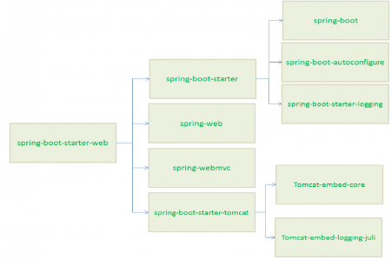
Springboot Starter

Slide 19
Spring Boot Components
Spring Boot Auto Configure
Module to auto configure a wide range of Spring projects.
It will detect availability of certain frameworks (Spring Batch, Spring Data JPA, Hibernate, JDBC).
When detected it will try to auto configure that framework with some sensible defaults, which in general can be overridden by configuration in an application.properties/yml file.

Slide 20
Spring Boot Components
Spring Boot Core
The base for other modules, but it also provides some functionality that can be used on its own, eg. using command line arguments and YAML files as Spring Environment property sources and automatically binding environment properties to Spring bean properties (with validation).

Slide 21
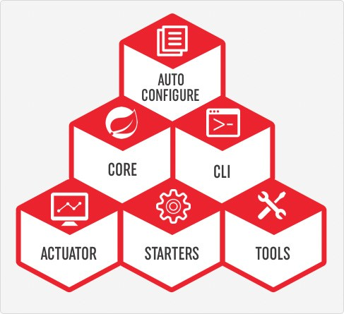
Spring Boot Components
Spring Boot CLI
A command line interface, based on ruby, to start/stop spring boot created applications.

Slide 22
SpringBoot CLI
To work with Spring boot CLI, first we need to install it in our system. There are many ways to install Spring boot CLI. 1. Manual installation 2. Installation with SDKMAN! 3. OSX Homebrew installation 4. MacPorts installation 5. Command-line completion

Slide 23
SpringBoot CLI
Spring boot CLI using manual installation in my Windows 7 OS. Find the below steps. Step 1: Download Spring boot CLI using below link spring-boot-cli-{version}.RELEASE-bin.zip. Step 2: Unzip it and keep somewhere in your system. Suppose I have kept it as follows. C:\spring-1.4.3.RELEASE Now we need to set following environment variables in our system. 1. SPRING_HOME with the value C:\spring-1.4.3.RELEASE 2. PATH with the value C:\spring-1.4.3.RELEASE\bin Step 3: Now we will test our installation. Open the command prompt and type the command spring

Slide 24
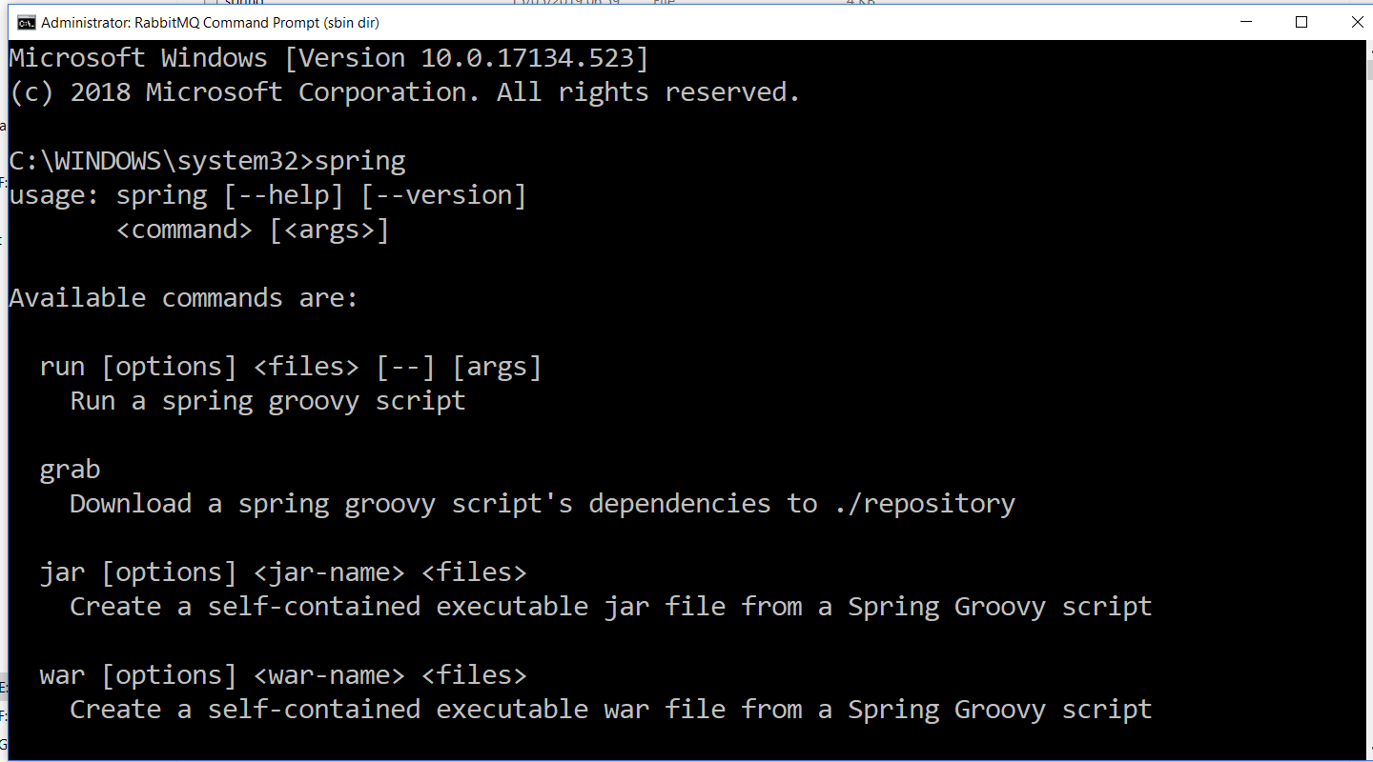
SpringBoot CLI

Slide 25
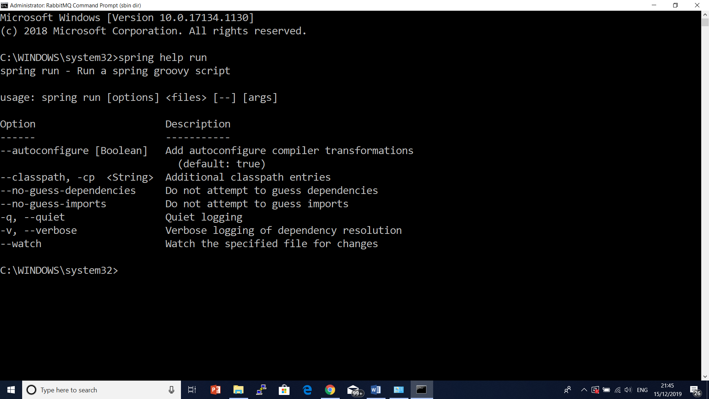

Slide 26
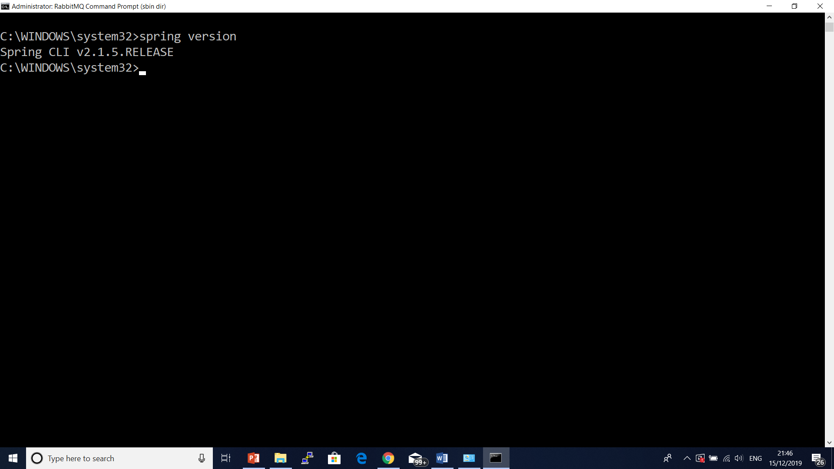

Slide 27
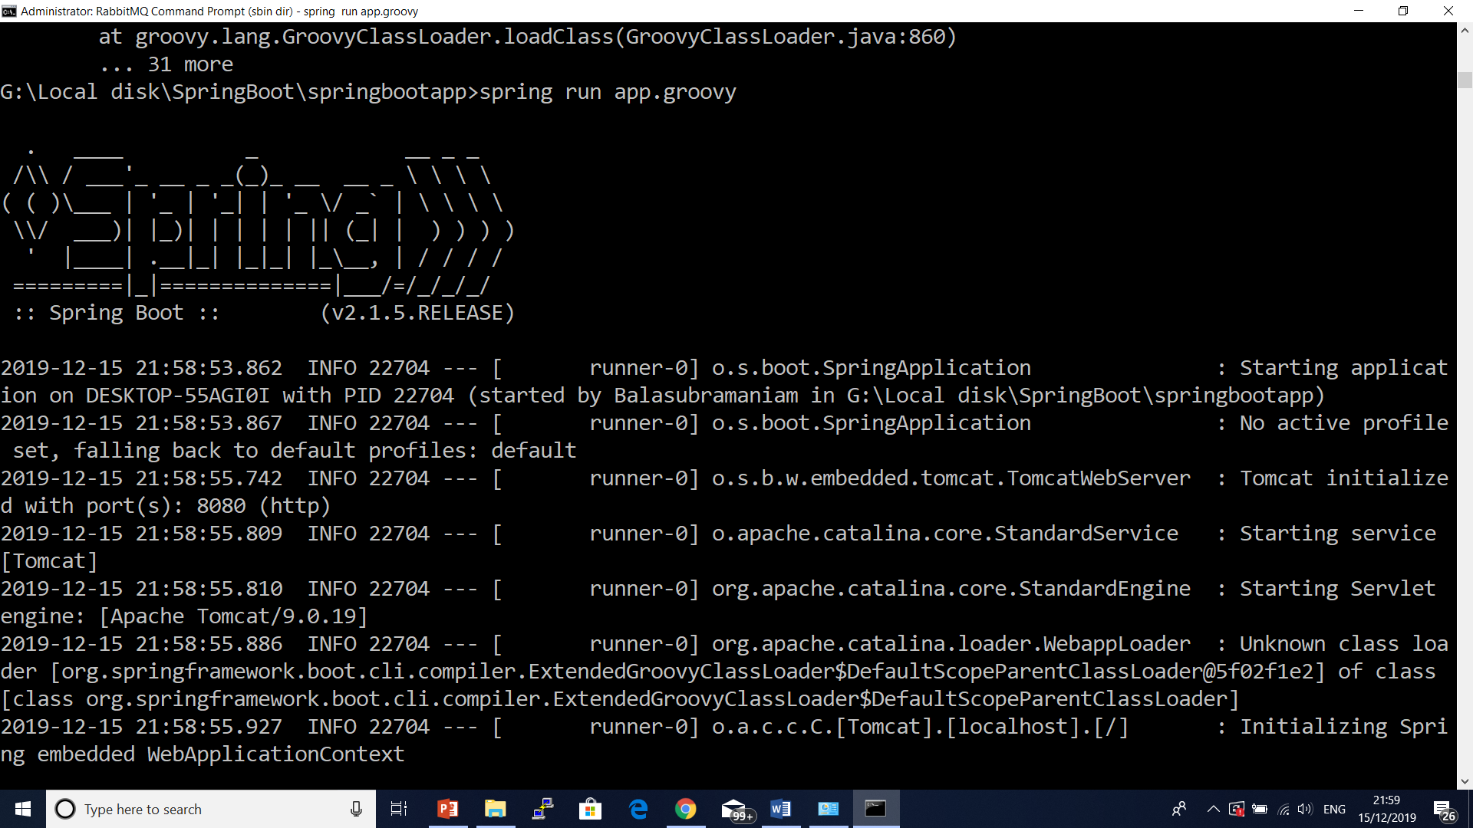

Slide 28


Slide 29


Slide 30
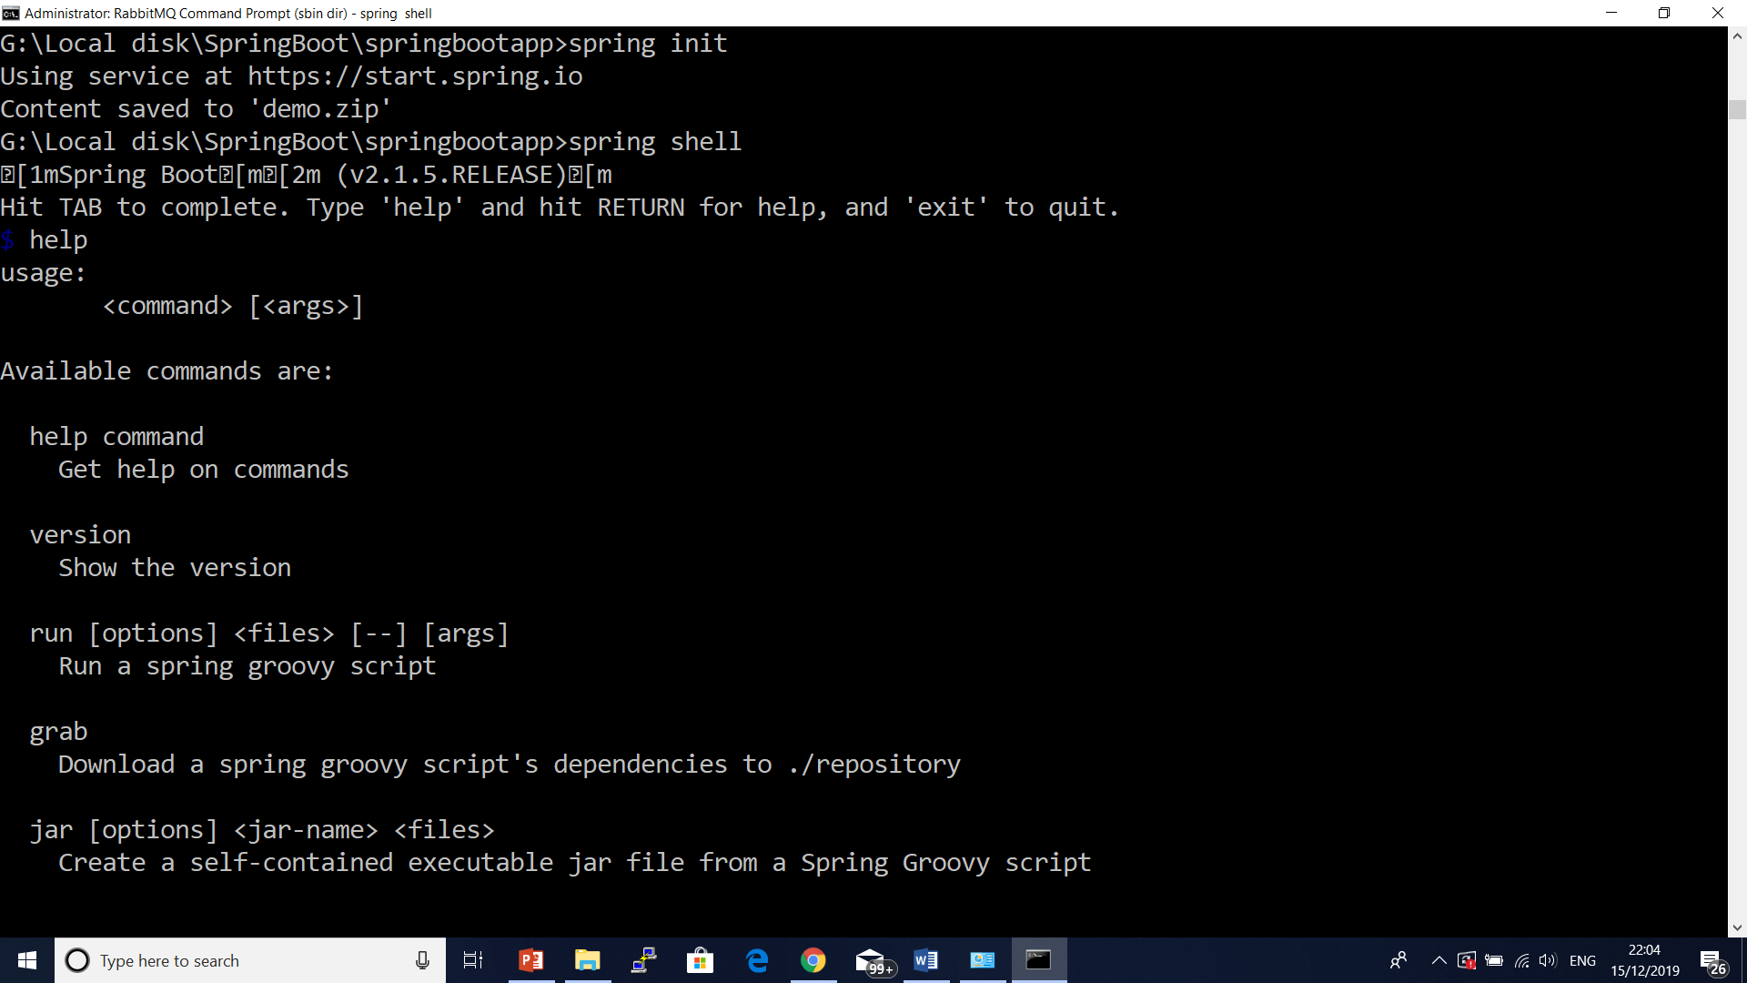

Slide 31
SpringBoot CLI
Create a New Project using Spring Boot CLI
spring init --dependencies=web,thymeleaf my-app.zip
In case we want to use Gradle build tool that will build a WAR file with any specific java version then we can run the command as follows.
spring init --build=gradle --java-version=1.8 --dependencies=web,thymeleaf --packaging=war my-app.zip
spring init --build=gradle --java-version=1.8 --dependencies=web,thymeleaf --packaging=war –group=com.nec –artifactId=testapi my-app.zip

Slide 32
Using Embedded Shell
Spring boot has command line completion scripts for BASH and Zsh shells. If we are using WINDOWS, spring boot provides shell command to launch an integrated shell. If using WINDOWS then launch integrated shell using the following command.
spring shell
Now we can directly run command without using spring keyword such as
$ version
$ test hello.groovy tests.groovy
$ run hello.groovy

Slide 33
Jetty server
Maven
<dependency>
<groupId>org.springframework.boot</groupId>
<artifactId>spring-boot-starter-web</artifactId>
<exclusions>
<exclusion>
<groupId>org.springframework.boot</groupId>
<artifactId>spring-boot-starter-tomcat</artifactId>
</exclusion>
</exclusions>
</dependency>
<dependency>
<groupId>org.springframework.boot</groupId>
<artifactId>spring-boot-starter-jetty</artifactId>
</dependency>

Slide 34
Jetty server
gradle
configurations {
compile.exclude module: "spring-boot-starter-tomcat"
}
dependencies {
compile("org.springframework.boot:spring-boot-starter-web:2.0.0.BUILD-SNAPSHOT")
compile("org.springframework.boot:spring-boot-starter-jetty:2.0.0.BUILD-SNAPSHOT")
}

Slide 35
Spring Boot 2.0 Configuration
@Bean
public ConfigurableServletWebServerFactory webServerFactory()
{
JettyServletWebServerFactory factory = new JettyServletWebServerFactory();
factory.setPort(9000);
factory.setContextPath("/myapp");
factory.addErrorPages(new ErrorPage(HttpStatus.NOT_FOUND, "/notfound.html"));
return factory;
}

Slide 36
HTTPS Configuration
Create your own self signed SSL certificate
To get SSL digital certificate for our application we have two options –
to create a self-signed certificate
to obtain SSL certificate from certification authority(CA) we call it CA certificate.

Slide 37
HTTPS Configuration
keytool -genkey -alias selfsigned_localhost_sslserver -keyalg RSA -keysize 2048 -validity 700 -keypass changeit -storepass changeit -keystore ssl-server.jks.
To view what is inside this keystore we can again use the keytool -list command as bellow.
keytool -list -keystore ssl-server.jks

Slide 38
Logging
logging.level.org.springframework=DEBUG
logging.level.com.howtodoinjava=DEBUG
#output to a temp_folder/file
logging.file=${java.io.tmpdir}/application.log
# Logging pattern for the console
logging.pattern.console= %d{yyyy-MM-dd HH:mm:ss} - %msg%n
# Logging pattern for file
logging.pattern.file= %d{yyyy-MM-dd HH:mm:ss} [%thread] %-5level %logger{36} - %msg%

Slide 39
Actuator
An actuator is a manufacturing term that refers to a mechanical device for moving or controlling something.
Actuators can generate a large amount of motion from a small change.
Spring boot’s module Actuator allows you to monitor and manage application usages in production environment, without coding and configuration for any of them.

Slide 40
The Actuator
Actuator brings production-ready features to our application.
Monitoring our app, gathering metrics, understanding traffic or the state of our database becomes trivial with this dependency.
Actuator is mainly used to expose operational information about the running application – health, metrics, info, dump, env, etc. It uses HTTP endpoints or JMX beans to enable us to interact with it.
Once this dependency is on the classpath several endpoints are available for us out of the box. As with most Spring modules, we can easily configure or extend it in many ways.

Slide 41
The Actuator
Adds common non-functional features to your application and exposes endpoints to interact with them (REST, JMX)
• Secure endpoints: /env, /metrics, /trace, /dump, /shutdown, /beans, /
autoconfig, /configprops, /mappings
• /info
• /health
• Audit
If embedded in a web app or web service can use the same port or a different one
(management.port) and/or a different network interface (management.address)
and/or context path (management.context-path).

Slide 42
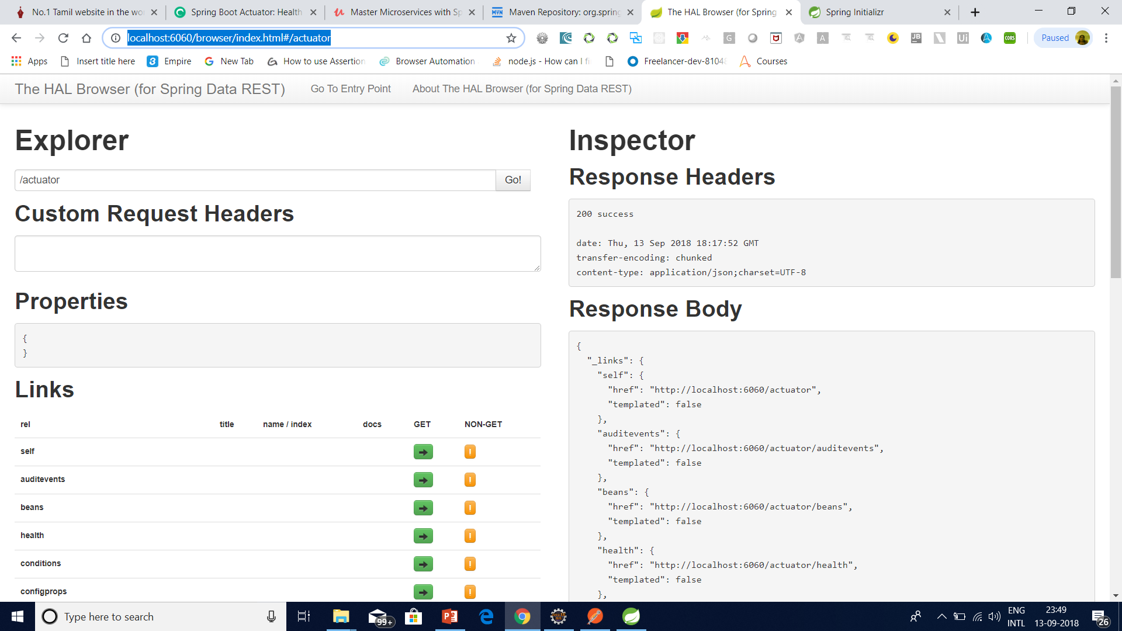
The Actuator – spring –data-hal-browser http://localhost:6060/browser/index.html

Slide 43
Actuator
ENDPOINT | USAGE
/env | Returns list of properties in current environment
/health | Returns application health information.
/auditevents | Returns all auto-configuration candidates and the reason why they ‘were’ or ‘were not’ applied.
/beans | Returns a complete list of all the Spring beans in your application.

Slide 44
Actuator
/trace | Returns trace logs (by default the last 100 HTTP requests).
/dump | It performs a thread dump.
/metrics | It shows several useful metrics information like JVM memory used, system CPU usage, open files, and much more.
http://localhost:7070/browser/index.html#/actuator/metrics/system.cpu.usage

Slide 45
Actuator
DataSourceHealthIndicator (seen in above example)
MongoHealthIndicator
Neo4jHealthIndicator
CassandraHealthIndicator
RedisHealthIndicator
CassandraHealthIndicator
RabbitHealthIndicator
CouchbaseHealthIndicator
DiskSpaceHealthIndicator (seen in above example)
ElasticsearchHealthIndicator
InfluxDbHealthIndicator
JmsHealthIndicator
MailHealthIndicator
SolrHealthIndicator

Slide 46
Actuator(Health indicator customization)
@Component
public class ServiceAHealthIndicator implements HealthIndicator {
private final String message_key = "Service A";
@Override
public Health health() {
if (!isRunningServiceA()) {
return Health.down().withDetail(message_key, "Not Available").build();
}
return Health.up().withDetail(message_key, "Available").build();
}
private Boolean isRunningServiceA() {
Boolean isRunning = true;
// Logic Skipped
return isRunning;
}
}

Slide 47
Logging
private final Logger LOGGER = LoggerFactory.getLogger(this.getClass());
@RequestMapping("/")
public String home(Map<String, Object> model) {
LOGGER.debug("This is a debug message");
LOGGER.info("This is an info message");
LOGGER.warn("This is a warn message");
LOGGER.error("This is an error message");
model.put("message", "HowToDoInJava Reader !!");
return "index";
}

Slide 48
Spring Cache
The Spring Framework provides support for transparently adding caching to an application. At its core, the abstraction applies caching to ecutions based on the information available in the cache.
This support is available from Spring Framework 3.1 and there is significant improvement provided in the Spring 4.1.
This is an abstract framework where Spring only provides the layer where other third party caching implementations can be easily plugged for storing data means cache storage is not implemented by Spring, where as enabling and caching is supported by spring out of the box.
Caching is supported for the methods and it works well if the methods return the same result for the given input for the multiple invocations.

Slide 49
Supported cache providers in Spring
Generic
JCache (JSR-107)
EhCache 2.x
Hazelcast
Infinispan
Couchbase
Redis
Caffeine
Guava
Simple

Slide 50
Use Caching With Annotations
After enabling the cache we can use following list of declarative annotations.
@Cacheable
@CacheEvict
@CachePut
@Caching
@CacheConfig

Slide 51
Use Caching With Annotations
@EnableCaching to enable caching because caching in spring is not enabled by default. The caching feature can be declaratively enabled by simply adding the @EnableCaching annotation to any of the configuration classes.
@Cacheable: It is one of the most important and common annotation for caching the requests.
If you annotate a method with @Cacheable, if multiple requests are received by the application, then this annotation will not execute the method multiple times, instead it will send the result from the cached storage.

Slide 52
Use Caching With Annotations
@CacheEvict:
If we annotate all methods with @Cacheable then the size of cache may be some problem.
We don’t want to populate the cache with values that we don’t need often.
Caches can grow quite large, quite fast, and we could be holding on to a lot of stale or unused data.
@CacheEvict annotation is used for removing a single cache or clearing the entire cache from the cache storage so that fresh values can be loaded into the cache again:

Slide 53
Use Caching With Annotations
@CachePut:
@CachePut annotation helps for updating the cache with the latest execution without stopping the method execution. The difference between @Cacheable and @CachePut is that @Cacheable will skip running the method, whereas @CachePut will actually run the method and then put its results in the cache.

Slide 54
Use Caching With Annotations
@Caching:
What if you want to use multiple annotations of the same type for caching a method? @Caching annotation used for grouping multiple annotations of the same type together when one annotation is not sufficient for the specifying the suitable condition. For example, you can put multiple @CacheEvict or @CachePut annotation inside @Caching to narrow down your conditions as you need.

Slide 55
Use Caching With Annotations
@CacheConfig:
You can annotate @CacheConfig at the class level to avoid repeated mentioning in each method. For example, in the class level you can provide the cache name and in the method you just annotate with @Cacheable annotation.
.

Slide 56
Spring Boot Components
Spring Boot Actuator
This project, when added, will enable certain enterprise features (Security, Metrics, Default Error pages) to your application.
As the auto configure module it uses auto detection to detect certain frameworks/features of your application.
For an example, you can see all the REST Services defined in a web application using Actuator

Slide 57
Hateos
The Spring HATEOAS project is a library of APIs that we can use to easily create REST representations that follow the principle of HATEOAS (Hypertext as the Engine of Application State).
Spring HATEOAS offers three abstractions for creating the URI – ResourceSupport, Link, and ControllerLinkBuilder.

Slide 58
Spring Boot Components
Spring Boot Starters
Different quick start projects to include as a dependency in your maven or gradle build file.
It will have the needed dependencies for that type of application. Currently there are many starter projects and many more are expected to be added.

Slide 59
Spring Boot Components
For example, if you go to a student page, you will see
Student profile
Links to Edit and Delete Student details
Links to see details of other students
Link to see details of the courses and grades of the student
HATEOAS brings the same concepts to RESTful Web Services.

Slide 60
Spring Boot Components
Spring Boot Tools
The Maven and Gradle build tool as well as the custom Spring Boot Loader (used in the single executable jar/war) is included in this project.

Slide 61
Spring Boot Installation
Requirements:
• Java (>=1.6) + (for Java projects)
• Maven 3.2+ or Gradle 1.12+
! Spring Tool Suite has some nice features for Java projects
! Download: https://start.spring.io/spring.zip
! Unzip the distro (approx. 10MB), and find bin/ directory
! (You can also install Spring Boot CLI with gvm, brew or MacPorts)

Slide 62
Springboot 2.x Features
1.Java 8 is minimum version
2.Tomcat version 8.5 is minimum
3.Hibernate version 5.2 is minimum
4.Gradle version 3.4 is minimum
5.Added SpringBoot Starters for WebFlux and reactive support for Cassandra, MongoDB and Redis.
6.AutoConfiguration

Slide 63
Springboot 2.x Features
Actuator Endpoint change:
Before 2.*: http://localhost:8080/business-customer/profile/env will give the details.
From 2.*: http://localhost:8080/business-customer/profile/actuator/env will give the details.

Slide 64
Springboot 2.x Features
Endpoint properties in application.properties (to enable all endpoints)
management.endpoints.web.exposure.include=* management.endpoints.web.exposure.exclude=loggers
Connection Pool by default:
Before 2.*: tomcat CP
After 2.: HikariCP (from SpringBoot 2. You don't need to add HikariCP dependency and its config bean creation and its properties changes.)
Migration: https://spring.io/blog/2018/03/12/upgrading-start-spring-io-to-spring-boot-2

Slide 65
Servlet Containers
Name | Servlet Version
Tomcat 8.5 | 3.1
Jetty 9.4 | 3.1
Undertow 1.4 | 3.1

Slide 66
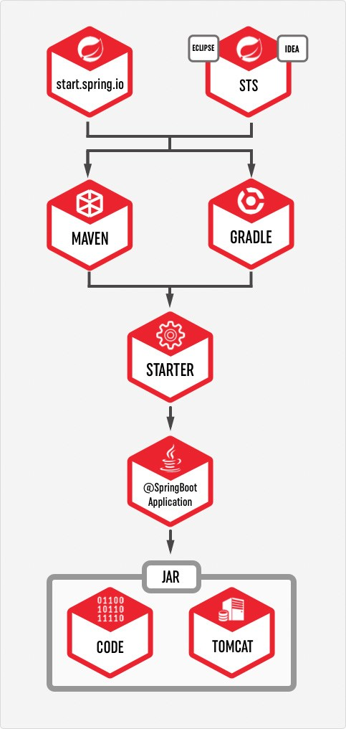
How to use Spring Boot

Slide 67
gradle
gradlew build --refresh-dependencies

Slide 68
Profile
application-dev.properties
application-qa.properties
application-stage.properties
application-prod.properties
At the time of launching the Java application
-Dspring.profiles.active=qa - in the VM properties, OR
Do the following in the application.properties file
spring.application.profiles=qa.

Slide 69
Annotations
OracleConfiguration will only be loaded if the class DataSource is present, in which case we can assume the application will use a database:
@Configuration
@ConditionalOnClass(DataSource.class)
class OracleAutoconfiguration {
//...
}
This bean to be created if a bean called dataSource is present and if a bean called entityManagerFactory is not already defined:
@Bean
@ConditionalOnBean(name = "dataSource")
LocalContainerEntityManagerFactoryBean entityManagerFactory() {
// ...
}

Slide 70
Annotations
transactionManager bean that will only be loaded if a bean of type JpaTransactionManager is not already defined:
@Bean
@ConditionalOnMissingBean(type = "JpaTransactionManager")
JpaTransactionManager transactionManager(EntityManagerFactory entityManagerFactory) {
JpaTransactionManager transactionManager = new JpaTransactionManager();
transactionManager.setEntityManagerFactory(entityManagerFactory);
return transactionManager;
}

Slide 71
Annotations
@Bean
@ConditionalOnProperty(
name = "usemysql",
havingValue = "local"
)
DataSource dataSource() {
// ...
}

Slide 72
Annotations
@ConditionalOnResource(resources = "classpath:mysql.properties")
Properties additionalProperties() {
// ...
}
@Bean
@ConditionalOnExpression("${usemysql} && ${mysqlserver == 'local'}")
DataSource dataSource() {
// ...
}

Slide 73
Annotations
@Conditional(HibernateCondition.class)
Properties additionalProperties() {
//...
}

Slide 74
What is Pivotal
Vmware and EMC spin out
• vFabric from vmware
• Greenplum MPP DB and Hadoop from EMC
• Agile development acquisitions Pivotal Labs and Xtreme Labs
Paul Maritz CEO
• Former CEO vmware.
Custodian of various OSS projects including Spring
• and RabbitMQ, Redis, CloudFondry, Groovy/Grails, …
Commercial interests in Big/Fast Data, PaaS, Enterprise tooling
• Spring is an enabling technology

Slide 75
Installing the Spring Boot CLI
The Spring Boot CLI (Command Line Interface) is a command line tool that you can use to quickly prototype with Spring.
It lets you run Groovy scripts, which means that you have a familiar Java-like syntax without so much boilerplate code.
You do not need to use the CLI to work with Spring Boot, but it is definitely the quickest way to get a Spring application off the ground.

Slide 76
Manual Installation
You can download the Spring CLI distribution from the Spring software repository:
spring-boot-cli-2.0.4.RELEASE-bin.zip
spring-boot-cli-2.0.4.RELEASE-bin.tar.gz

Slide 77
Manual Installation
set PATH=D:\spring-boot-cli- 1.2.3.RELEASE\bin;%PATH%
spring –version
Spring --help
@RestController
class HelloWorld {
@RequestMapping("/")
String hello() {
"Hello JournalDev World."
}
}
Name this file as HelloWorld.groovy. Here “.groovy” extension is mandatory.

Slide 78
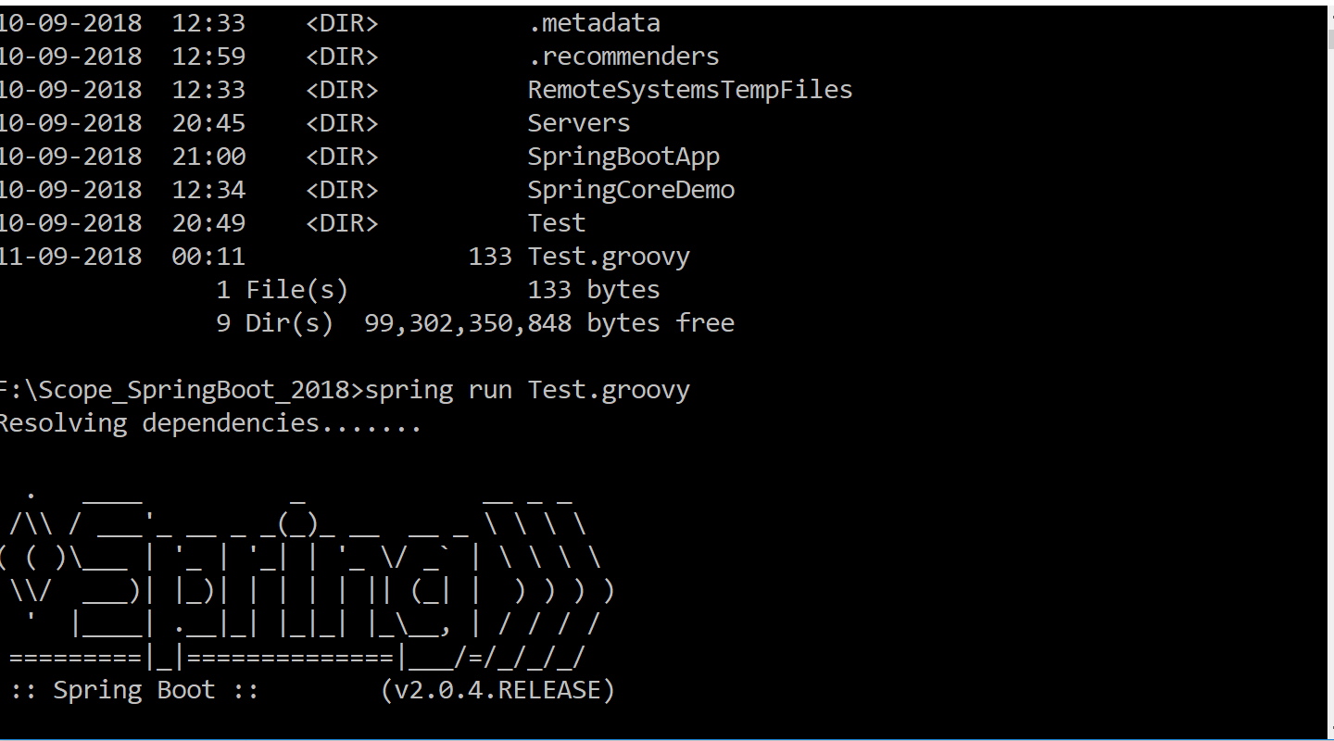
Manual Installation

Slide 79
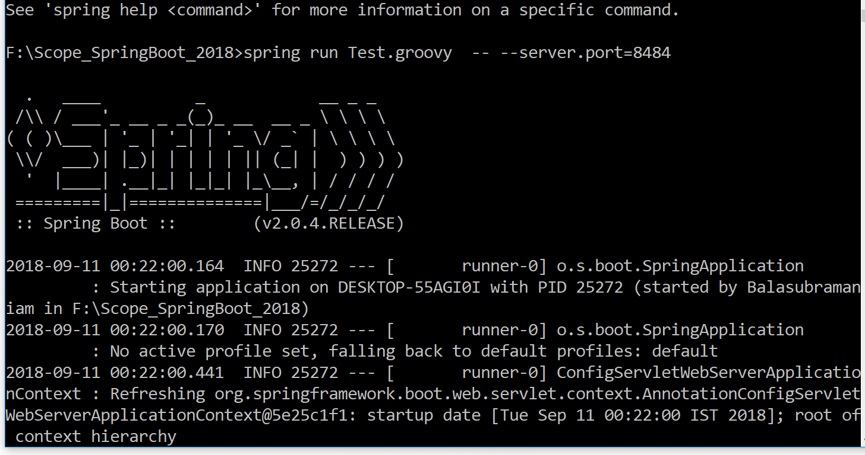
Manual Installation

Slide 80
Packaging For Production
Maven plugin (using spring-boot-starter-parent):
! Gradle plugin:
<plugin>
<groupId>org.springframework.boot</groupId>
<artifactId>spring-boot-maven-plugin</artifactId>
</plugin>
$ mvn package
apply plugin: 'spring-boot'
$ gradle build

Slide 81
Packaging For Production
Packaging For Production
$ java -jar yourapp.jar
! Easy to understand structure
! No unpacking or start scripts required
! Typical REST app ~10Mb
! Cloud Foundry friendly (works & fast to upload)

Slide 82
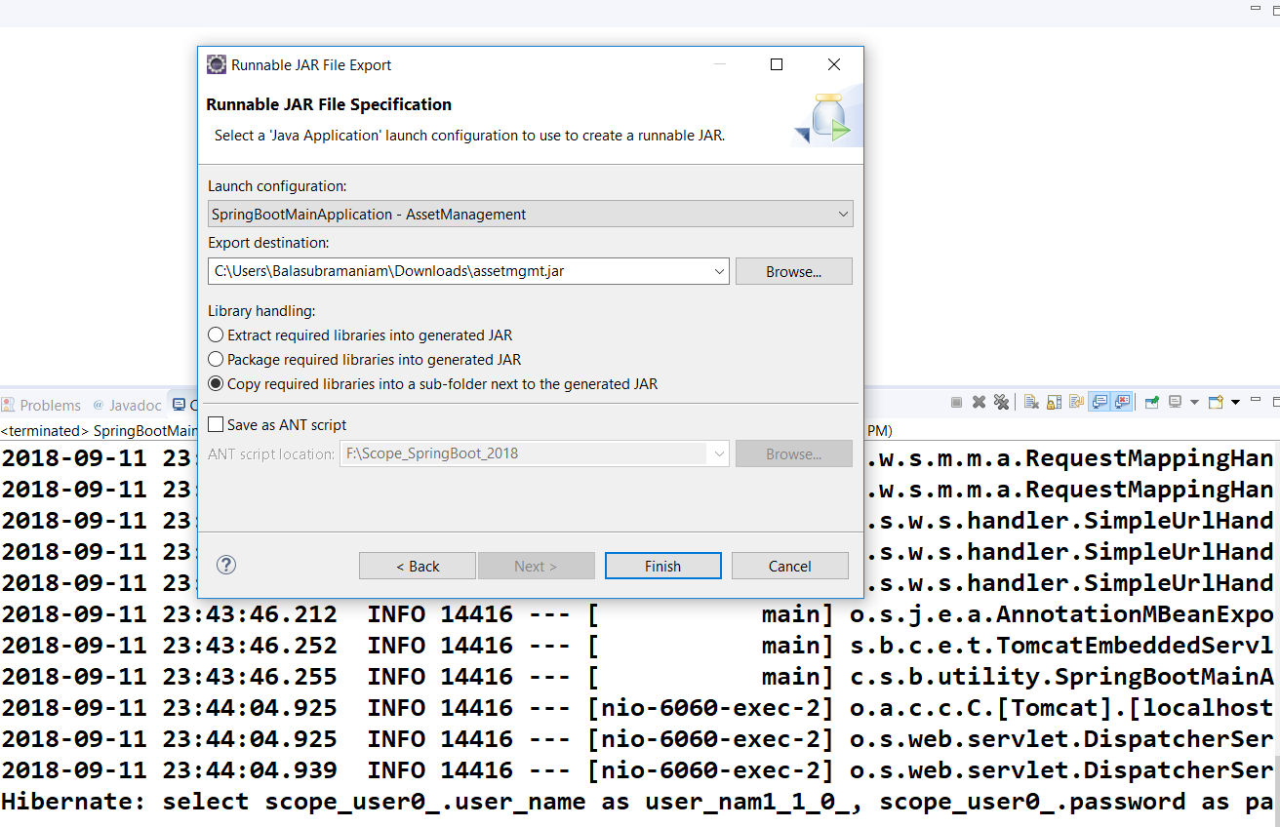

Slide 83
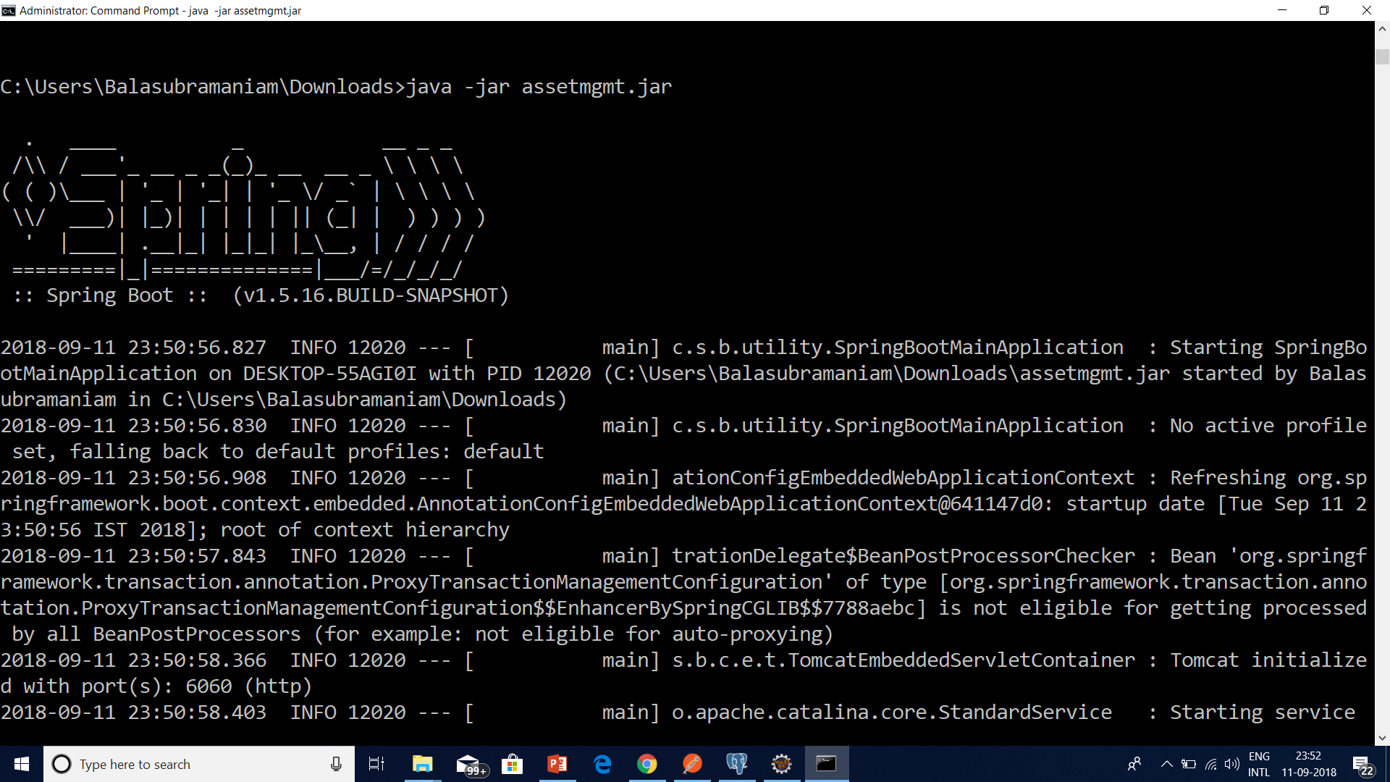

Slide 84
Logging Configuration in Spring Boot
Spring Boot provides support for logging and uses Commons Logging for all internal logging, but leaves the underlying log implementation open.
Default configurations are provided for Java Util Logging, Log4J2 and Logback.
In each case loggers are pre-configured to use console output with optional file output also available.

Slide 85
How to Deploy Spring Boot Application to Cloud Foundry Platform
Cloud Foundry is an open-source platform as a service (PaaS) that provides you with a choice of clouds, developer frameworks, and application services.
It is open source and it is governed by the Cloud Foundry Foundation.
The original Cloud Foundry was developed by VMware and currently it is managed by Pivotal, a joint venture company by GE, EMC and VMware.

Slide 86
Cloud Foundary Providers
Pivotal Cloud Foundry
IBM Bluemix
HPE Helion Stackato 4.0
Atos Canopy
CenturyLink App Fog
GE Predix
Huawei FusionStage
SAP Cloud Platform
Swisscom Application Cloud

Slide 87
Cloud Foundry Installation for Windows
Download the CF Windows installer. It will prompt for the download. Save the zip file distribution.
Unpack the zip file to a suitable place in your workstation.
After successfully unzip operation, double cick on the cf CLI executable.
When prompted, click Install, then Close.

Slide 88
Cloud Foundry Installation for Windows
Verify the installation by opening a terminal window and type cf. If your installation was successful, the cf CLI help listing appears.
This indicates that you are ready to go with any cloud foundry platform from your local workstation.

Slide 89
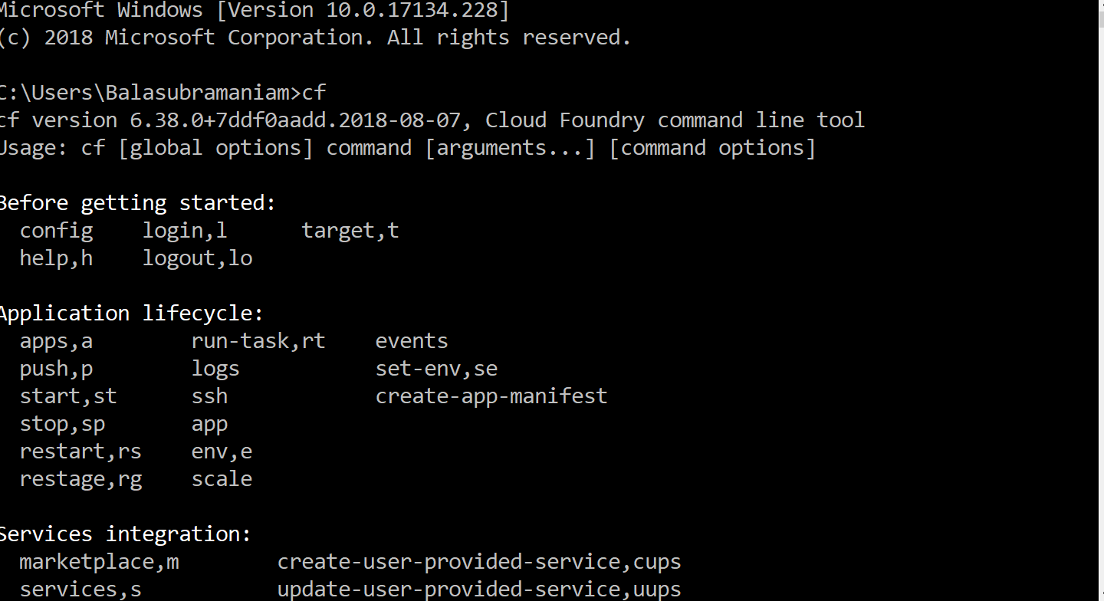

Slide 90
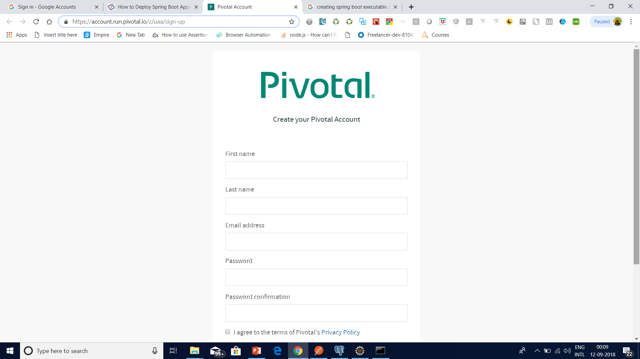

Slide 91
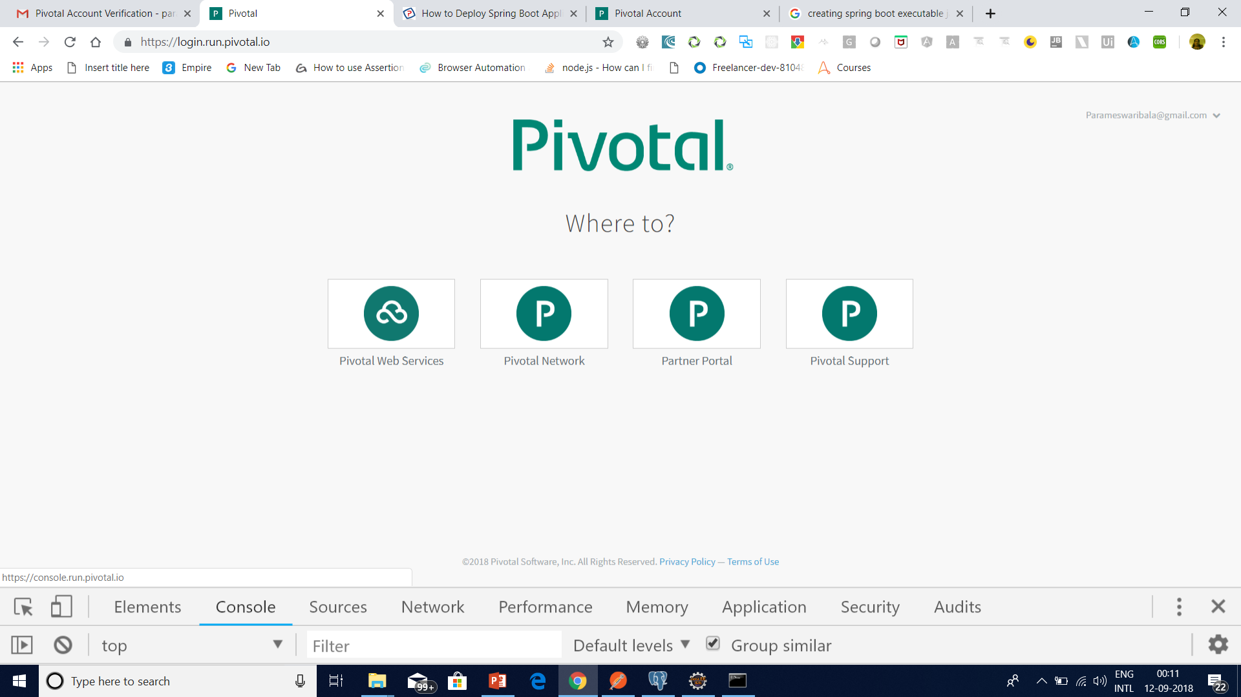

Slide 92
Login and logout from PWS Console using CLI
Login to PWS – We will use cf login -a api.run.pivotal.io
Logout from PWS Console – We will use command cf logout to logout from the platform, once we have all the work done for that session.

Slide 93
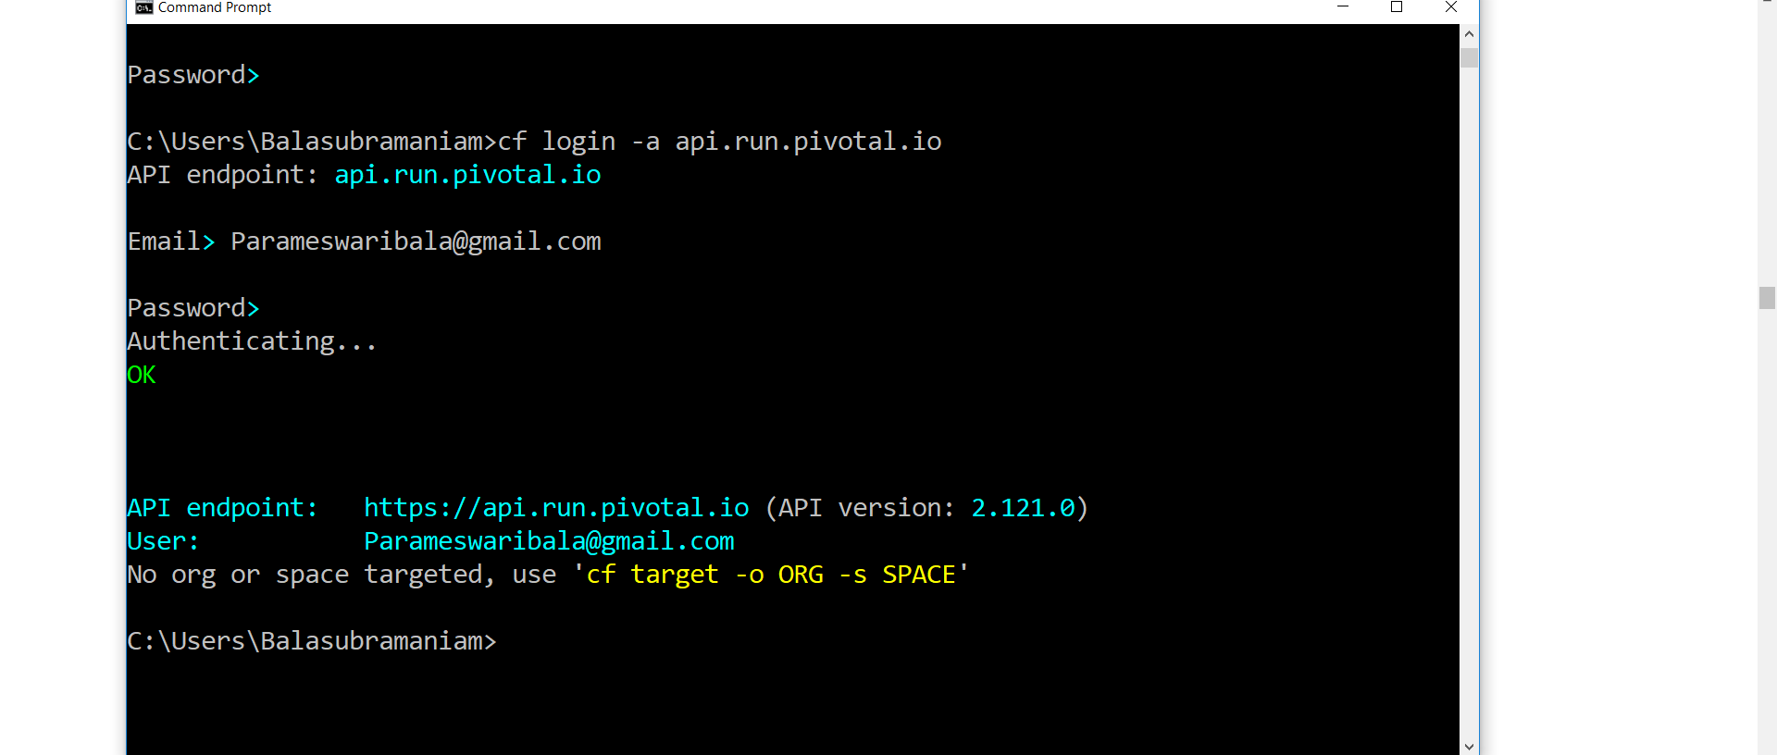

Slide 94
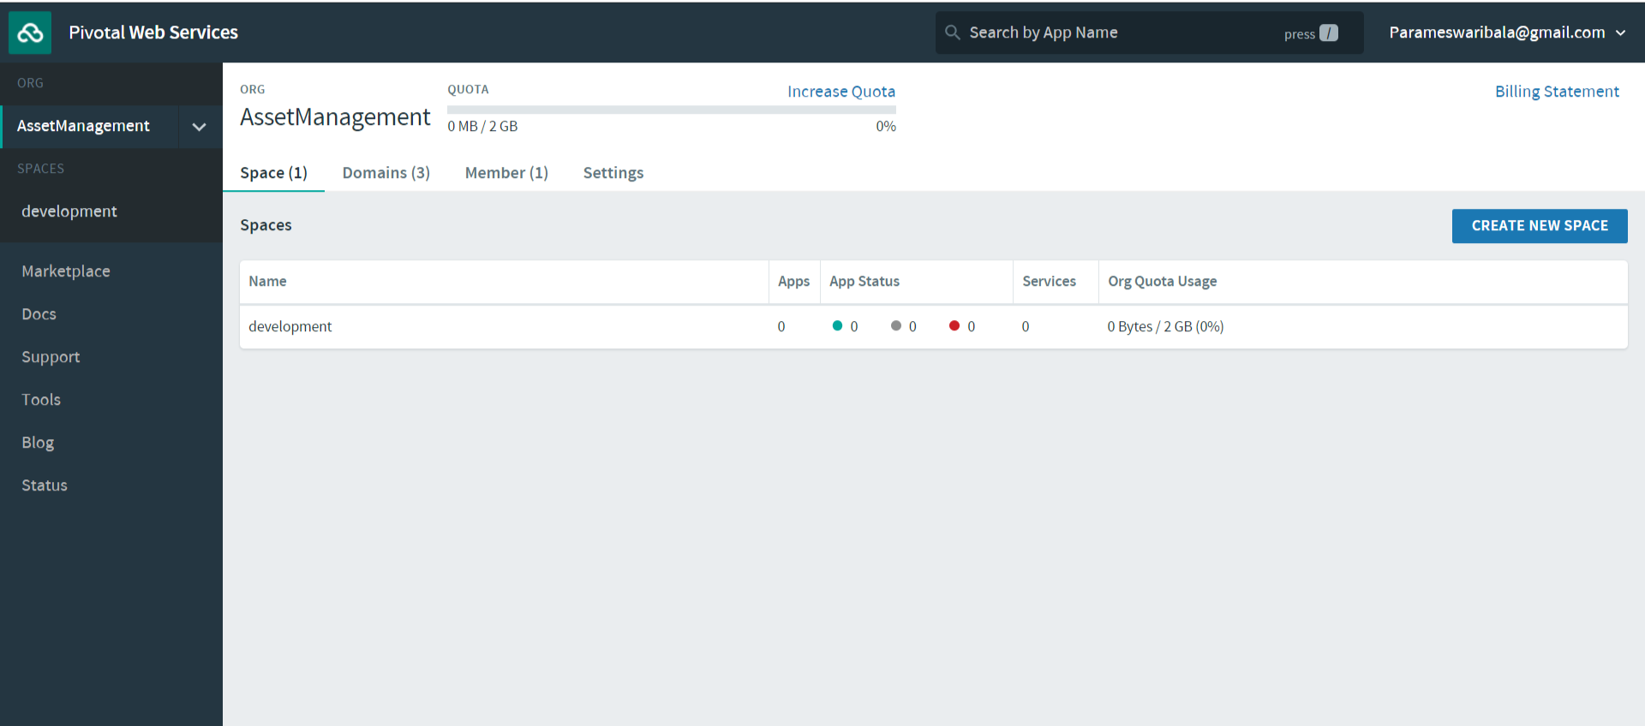

Slide 95
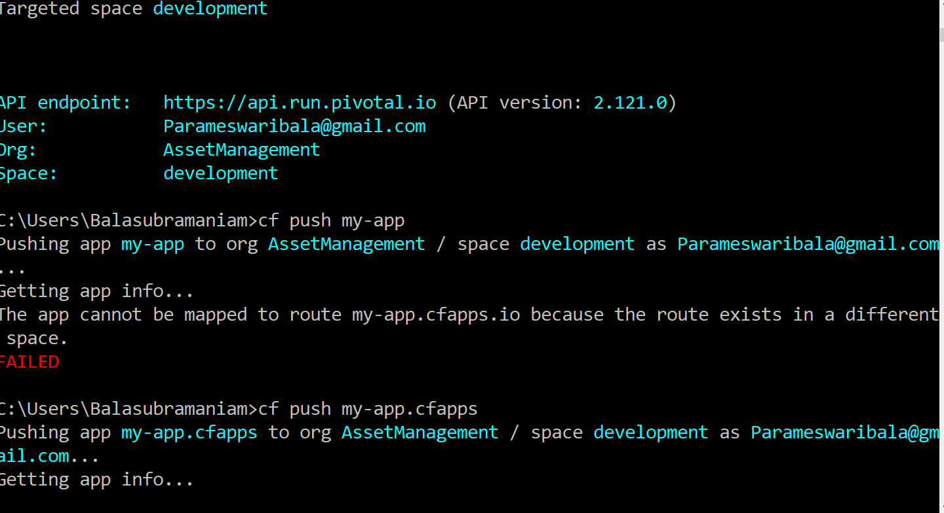

Slide 96
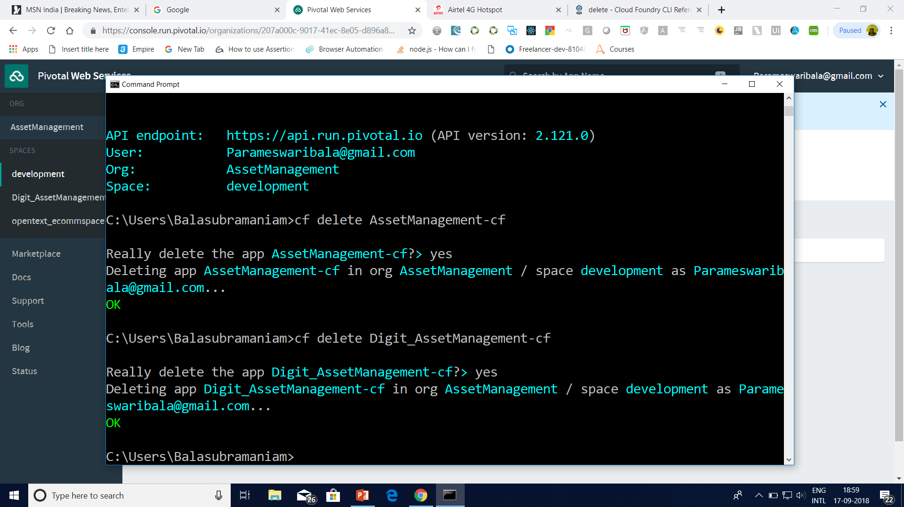

Slide 97
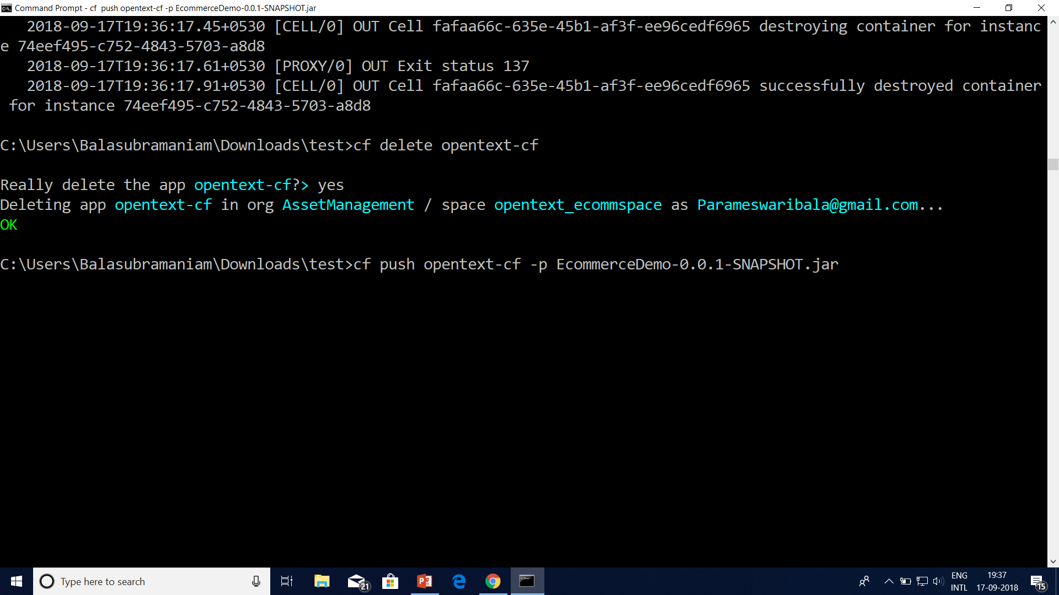

Slide 98
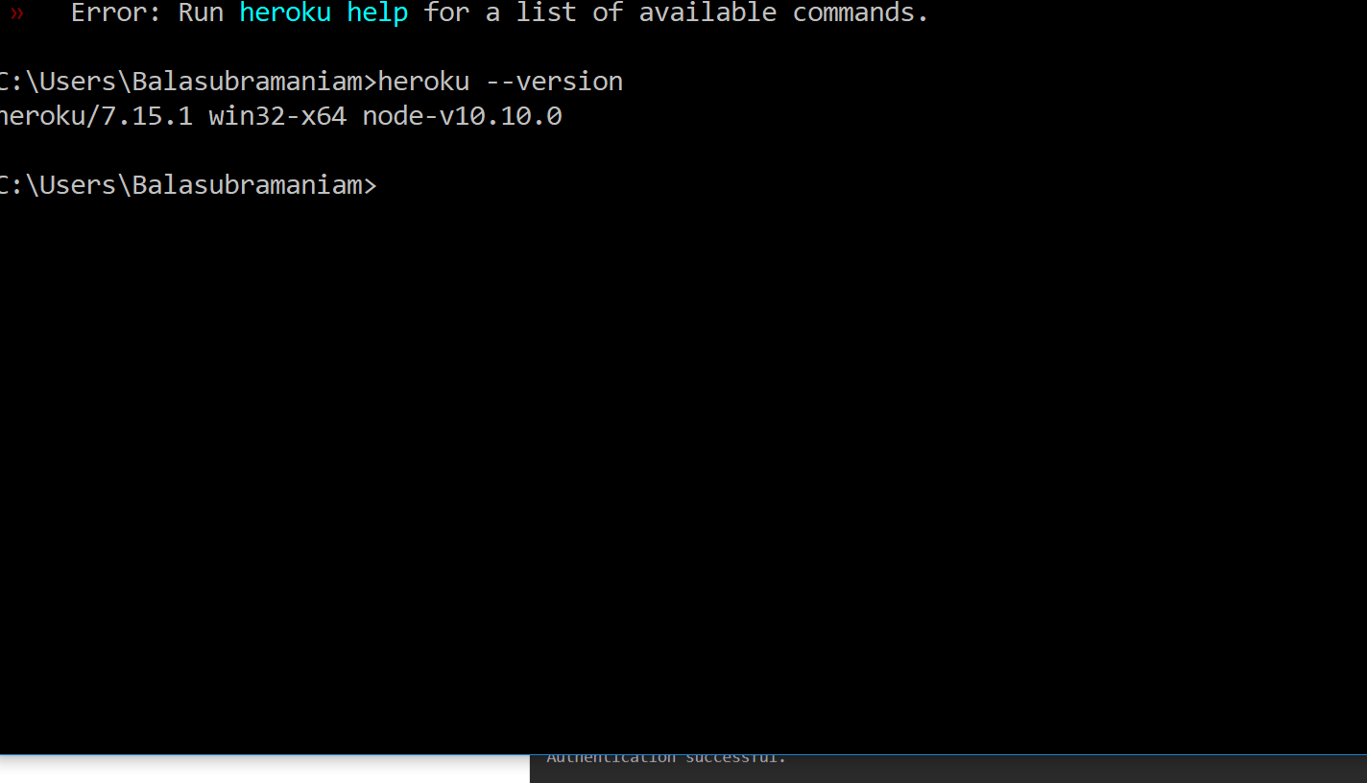
Heroku

Slide 99
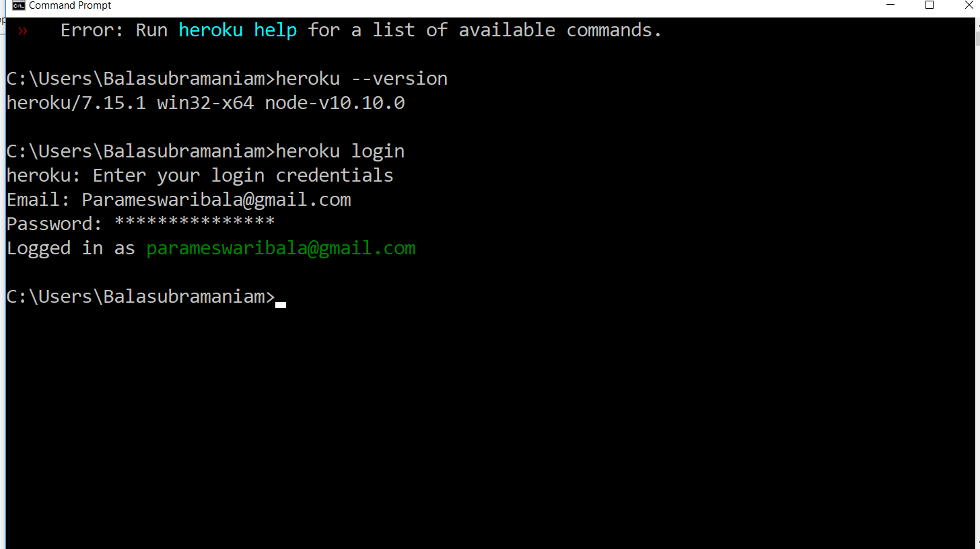

Slide 100
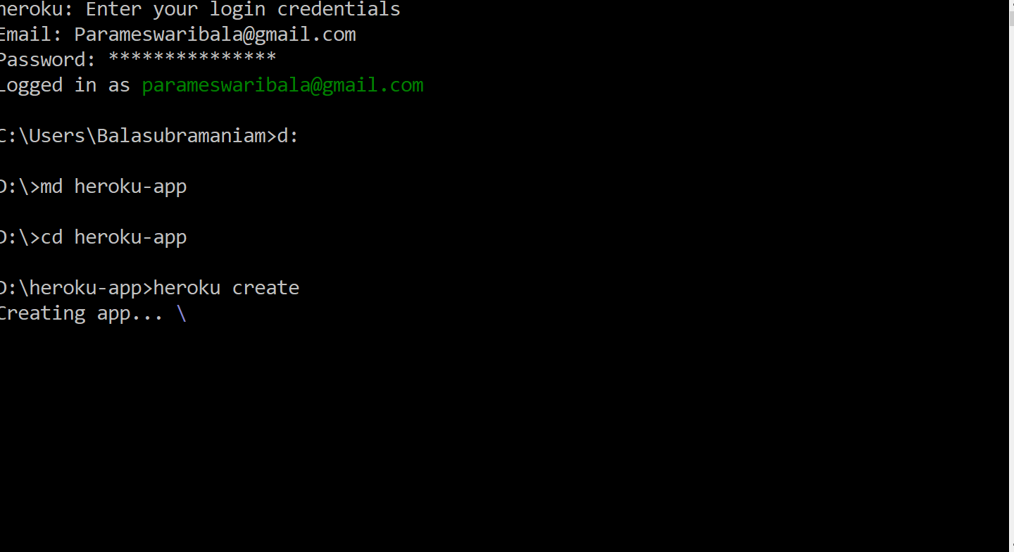

Slide 101
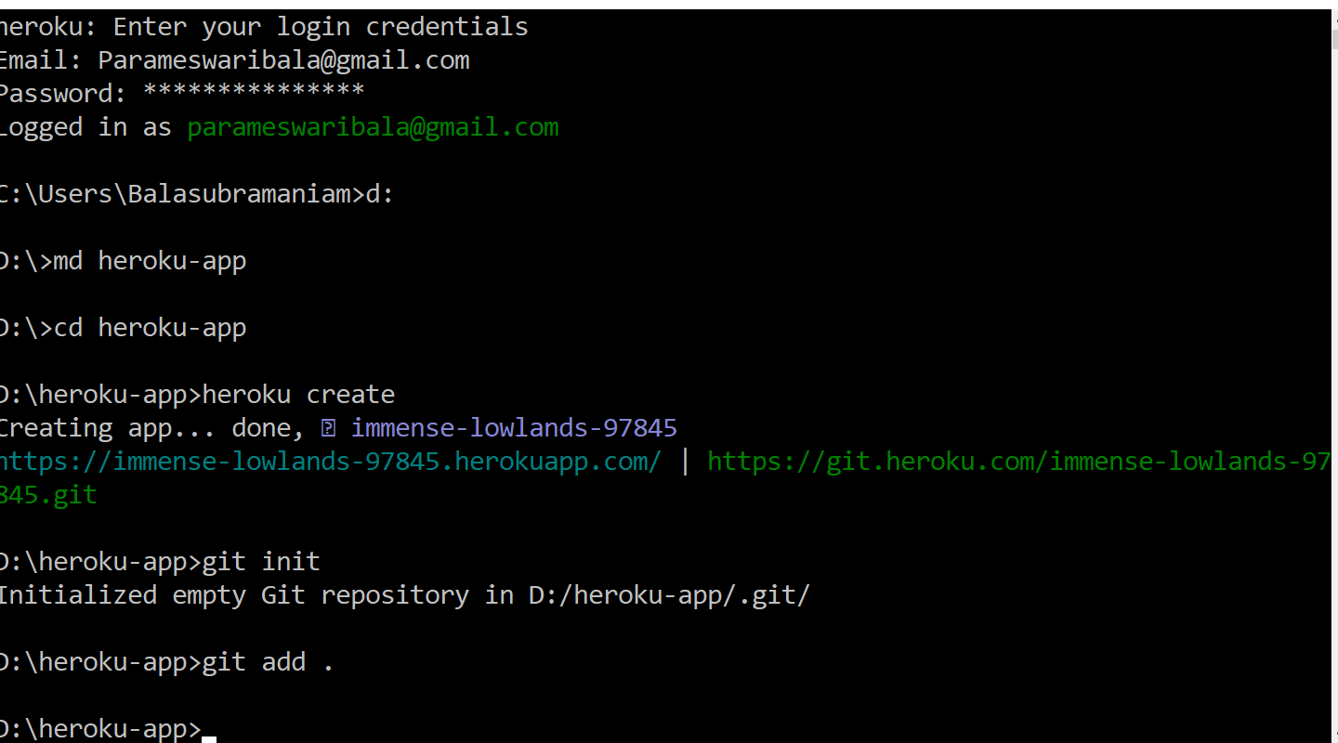

Slide 102
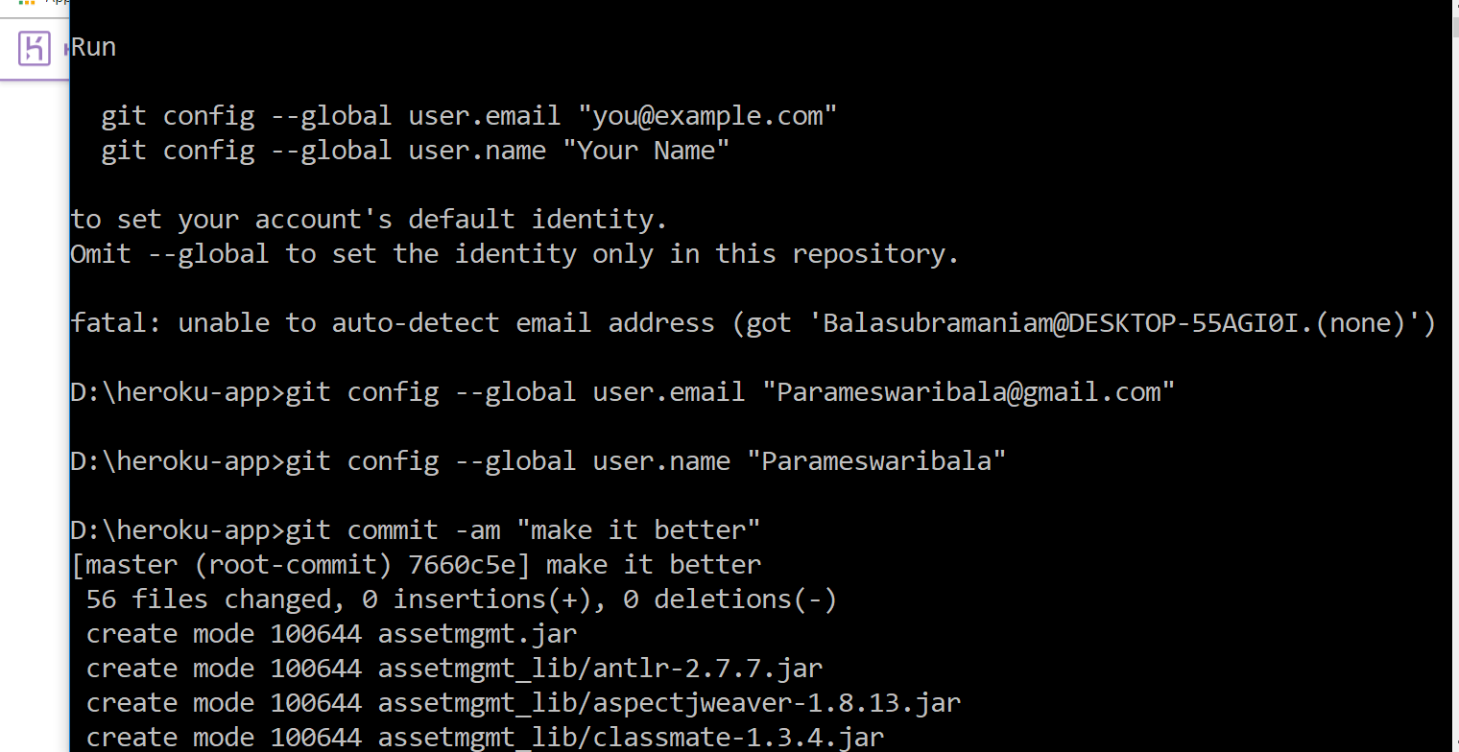

Slide 103
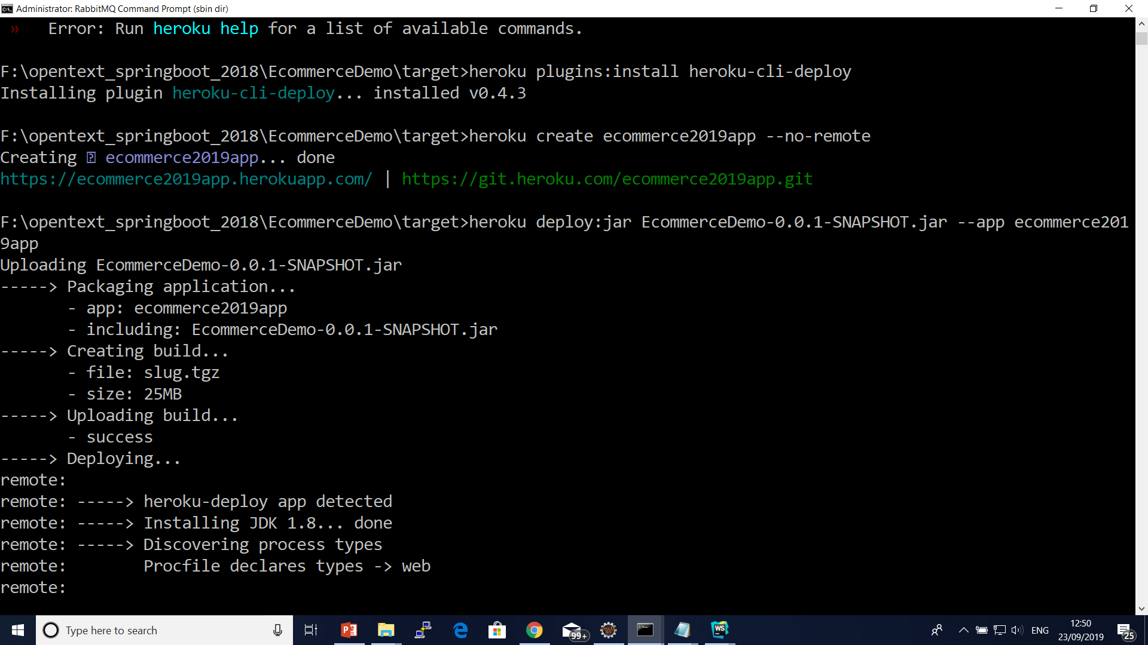

Slide 104
Using the Heroku Deploy CLI plugin
heroku addons:create heroku-postgresql:hobby-dev
heroku plugins:install heroku-cli-deploy
heroku create --no-remote
heroku deploy:jar target/my-app.jar --app sushi

Slide 105
Logging Configuration in Spring Boot
Date and Time: Millisecond precision and easily sort able.
Log Level: ERROR, WARN, INFO, DEBUG or TRACE.
Process ID.
A — Separator to distinguish the start of actual log messages.
Thread name: Enclosed in square brackets (may be truncated for console output).
Logger name: This is usually the source class name (often abbreviated).

Slide 106
Internationalization

Slide 107
Currently Available AutoConfiguration Behaviour
Data grid: Spring Data Gemfire, Solr and Elasticsearch
! Websocket
! Web services
! Mobile & Social (Facebook, Twitter and LinkedIn)
! Reactor for events and async processing
! Jersey
! JTA
! Email, CRaSH, AOP (AspectJ)
! Actuator features (Security, Audit, Metrics, Trace)

Slide 108
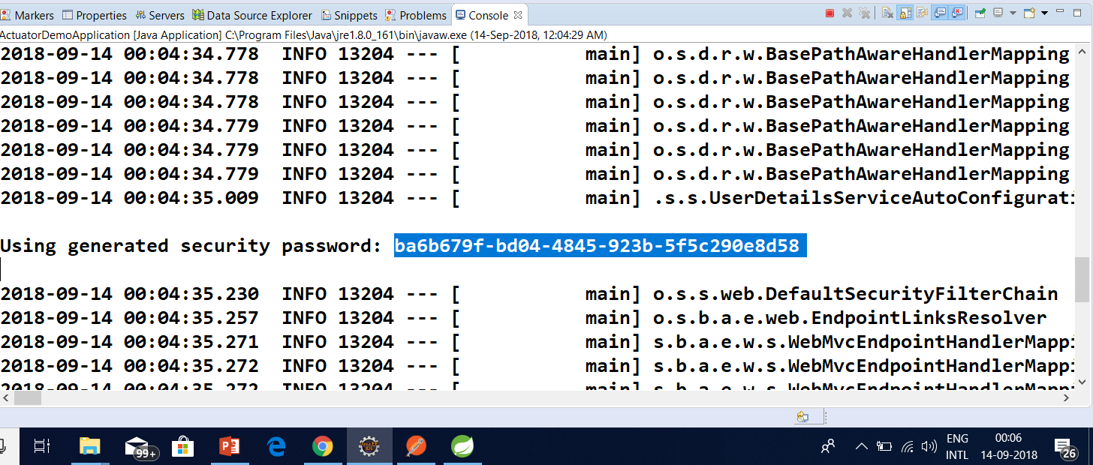
Spring Boot Security

Slide 109
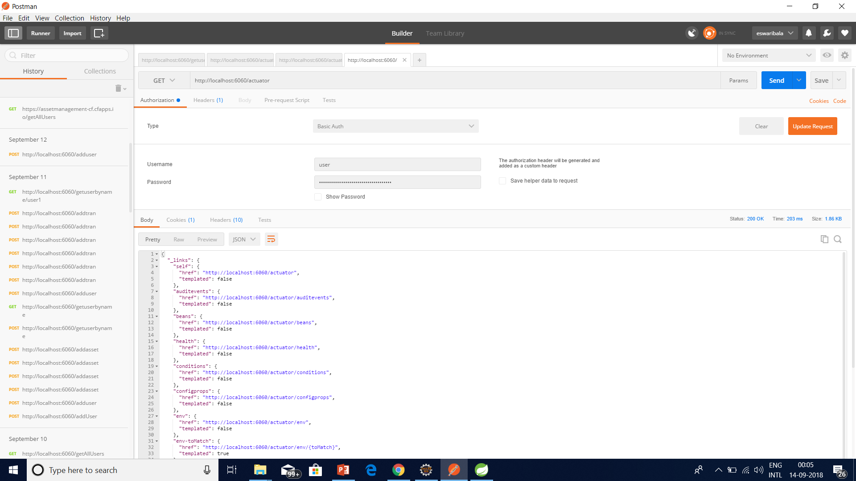
Spring Boot Security

Slide 110
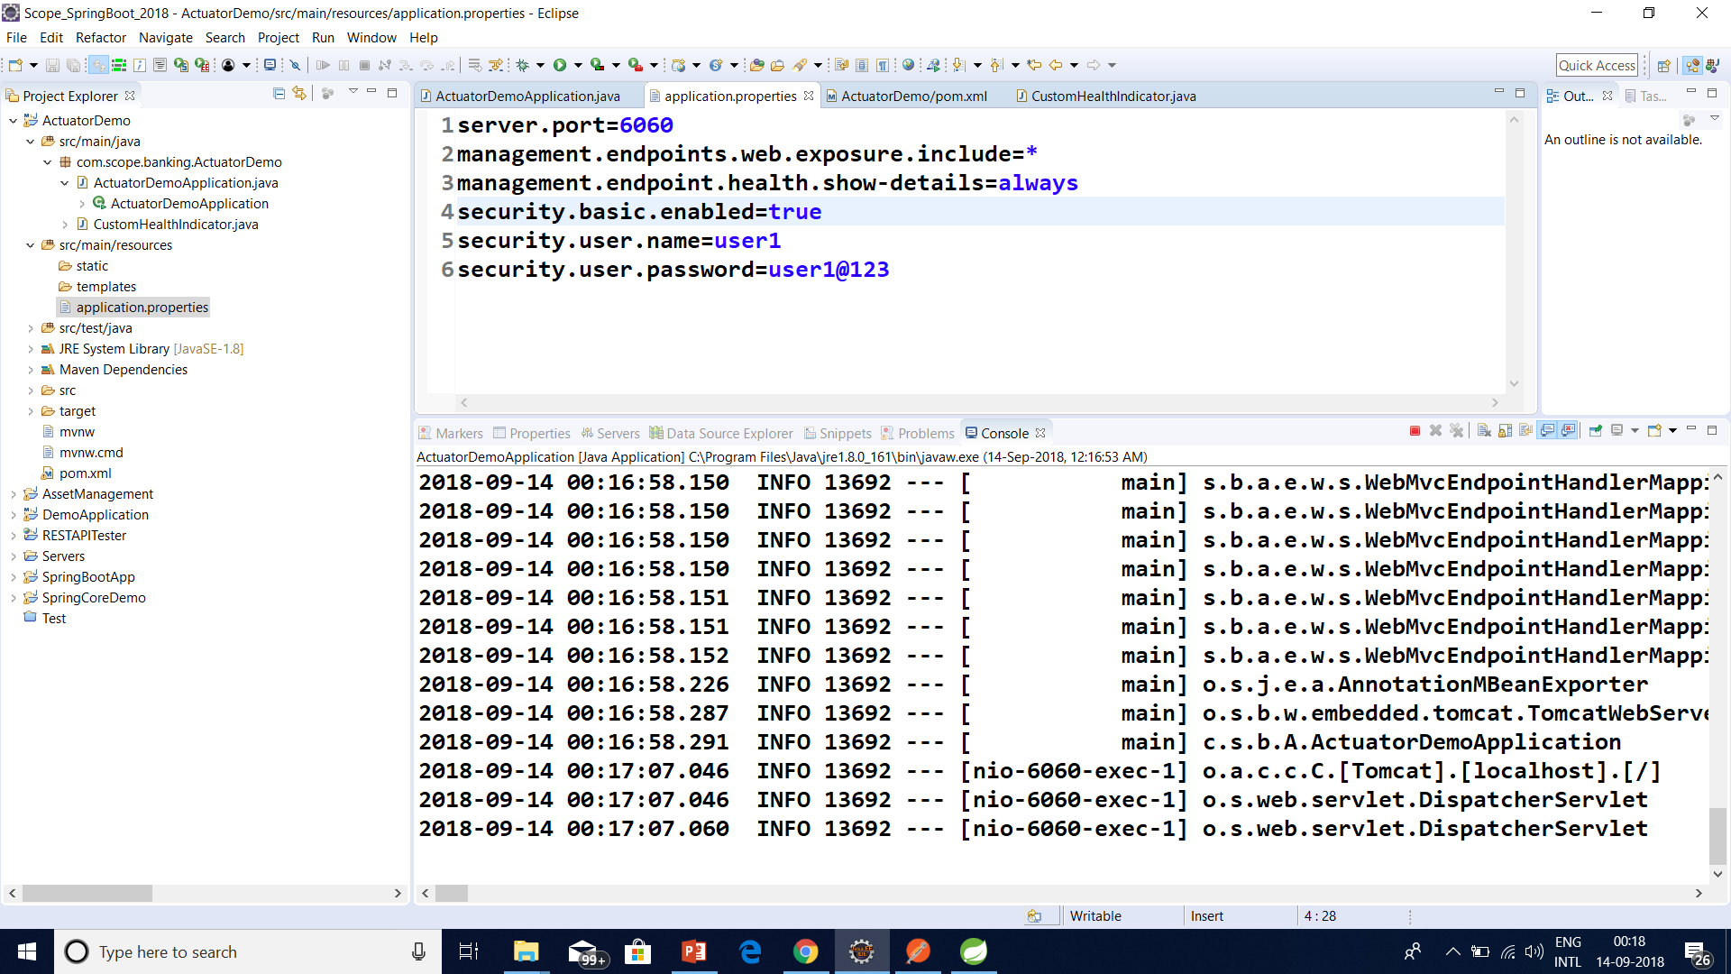
Spring Boot Security

Slide 111
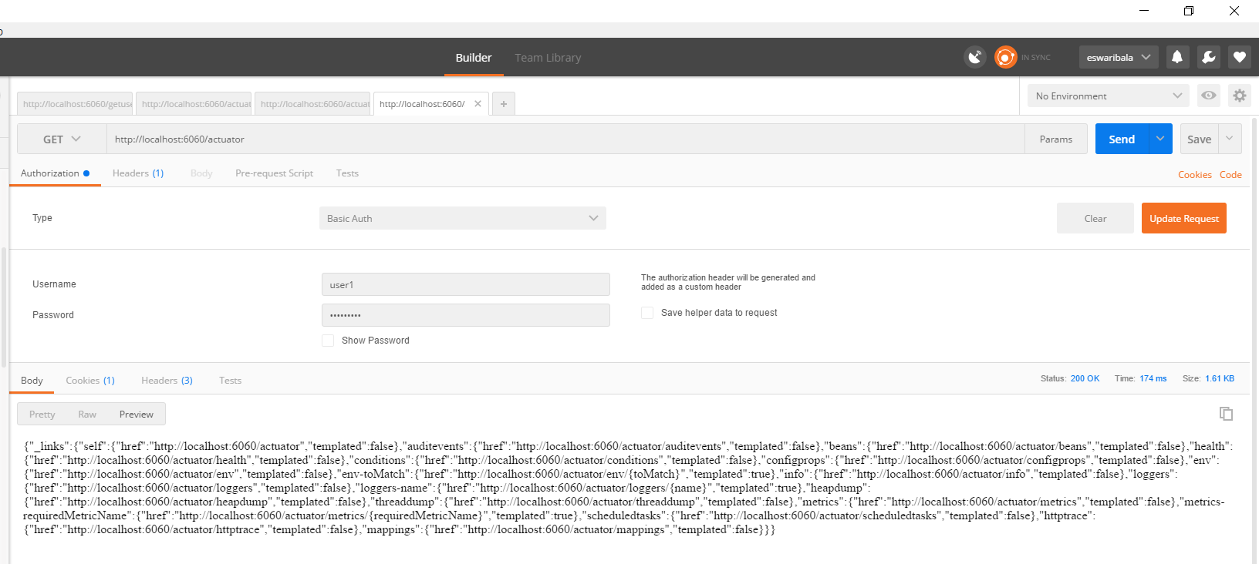
Spring Boot Security

Slide 112
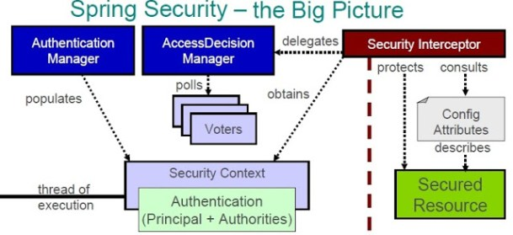
. SECURING AN APPLICATION WITH SPRING BOOT AND SPRING SECURITY

Slide 113
EnableGlobalMethodSecurity vs Enable Web Security
EnableGlobalMethodSecurity provides AOP security on methods, some of annotation it will enable are PreAuthorize PostAuthorize

Slide 114
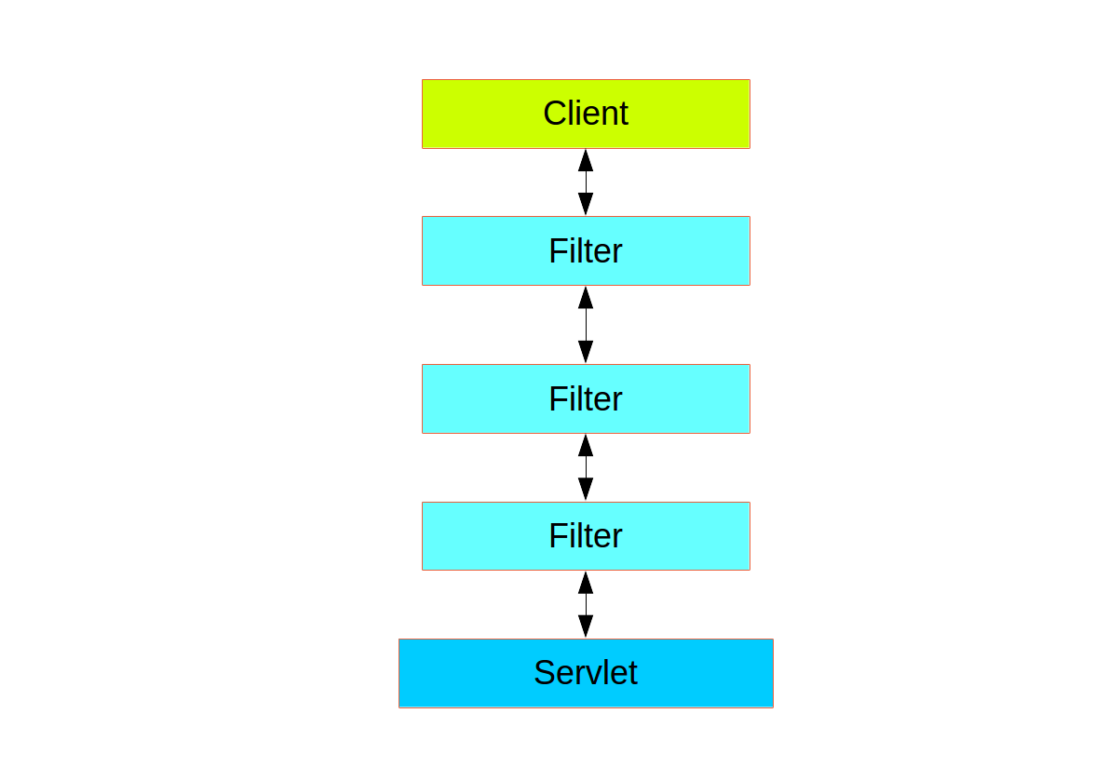
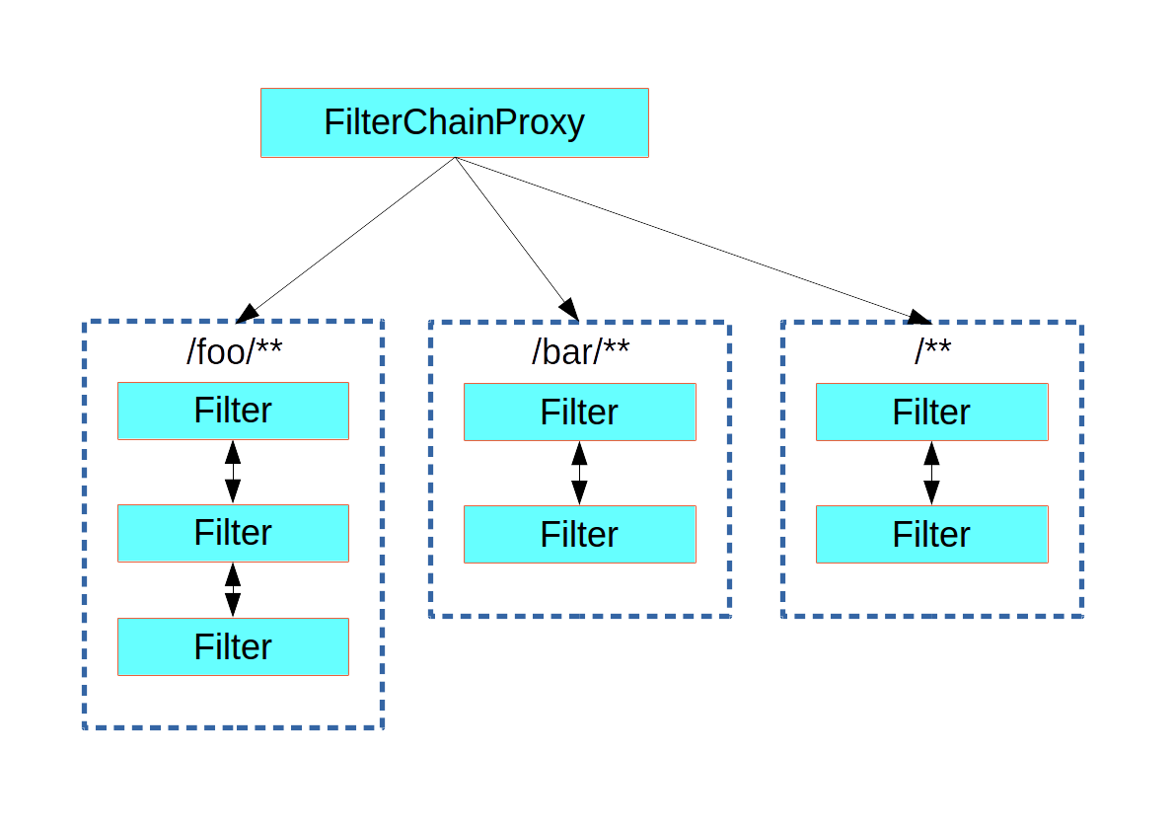
. SECURING AN APPLICATION WITH SPRING BOOT AND SPRING SECURITY

Slide 115
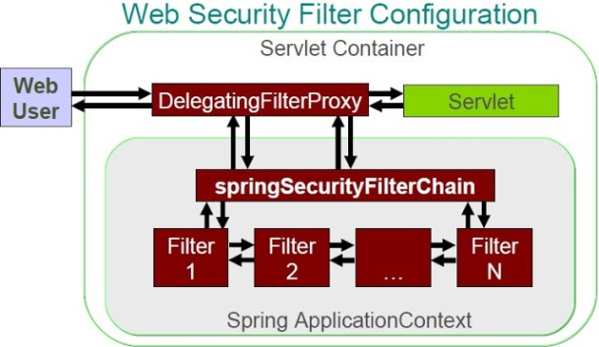
. SECURING AN APPLICATION WITH SPRING BOOT AND SPRING SECURITY

Slide 116
Reactive java programming
Reactive programming is a programming paradigm that promotes an asynchronous, non-blocking, event-driven approach to data processing.
Reactive programming involves modeling data and events as observable data streams and implementing data processing routines to react to the changes in those streams.

Slide 117
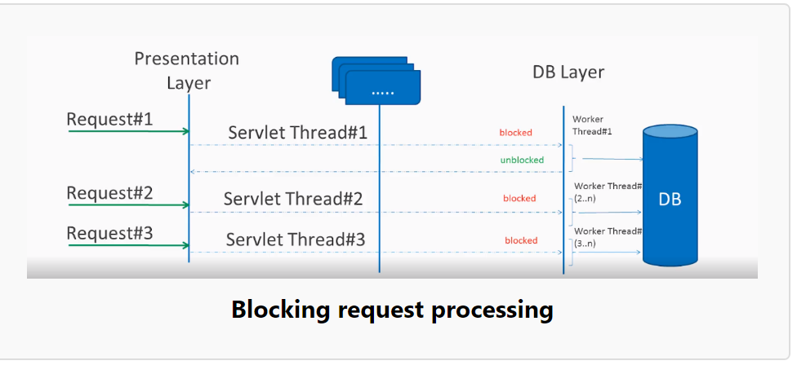
Blocking request processing

Slide 118
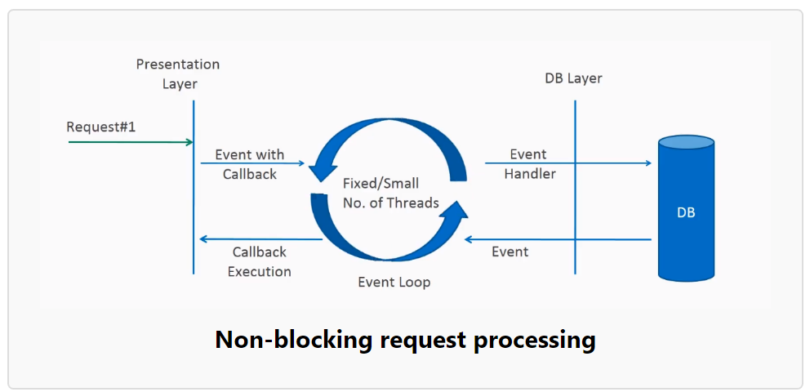
Non-blocking request processing

Slide 119
What is reactive programming?
The term, “reactive,” refers to programming models that are built around reacting to changes.
It is build around publisher-subscriber pattern (observer pattern).
In reactive style of programming, we make a request for resource and start performing other things.
When the data is available, we get the notification along with data inform of call back function.
In callback function, we handle the response as per application/user needs.

Slide 120
What is reactive programming?
One important thing to remember is back pressure.
In non-blocking code, it becomes important to control the rate of events so that a fast producer does not overwhelm its destination.
Reactive web programming is great for applications that have streaming data, and clients that consume it and stream it to their users.
It is not great for developing traditional CRUD applications.
If you’re developing the next Facebook or Twitter with lots of data, a reactive API might be just what you’re looking for.

Slide 121
Reactive Streams API
The new Reactive Streams API was created by engineers from Netflix, Pivotal, Lightbend, RedHat, Twitter, and Oracle, among others and is now part of Java 9.
It defines four interfaces:
Publisher: Emits a sequence of events to subscribers according to the demand received from its subscribers. A publisher can serve multiple subscribers.
It has a single method:
Publisher.java
public interface Publisher<T>
{
public void subscribe(Subscriber<? super T> s);
}

Slide 122
Reactive Streams API
Subscriber: Receives and processes events emitted by a Publisher. Please note that no notifications will be received until Subscription#request(long) is called to signal the demand.
It has four methods to handle various kind of responses received.
Subscriber.java
public interface Subscriber<T>
{
public void onSubscribe(Subscription s);
public void onNext(T t);
public void onError(Throwable t);
public void onComplete();
}

Slide 123
Reactive Streams API
Subscription: Defines a one-to-one relationship between a Publisher and a Subscriber. It can only be used once by a single Subscriber. It is used to both signal desire for data and cancel demand (and allow resource cleanup).
Subscription.java
public interface Subscription<T>
{
public void request(long n);
public void cancel();
}

Slide 124
Reactive Streams API
Processor: Represents a processing stage consisting of both a Subscriber and a Publisher and obeys the contracts of both.
Processor.java
public interface Processor<T, R> extends Subscriber<T>, Publisher<R>
{
}

Slide 125
Reactive Streams API
Two popular implementations of reactive streams are RxJava and Project Reactor

Slide 126
What is Spring WebFlux
Spring WebFlux is parallel version of Spring MVC and supports fully non-blocking reactive streams.
It support the back pressure concept and uses Netty as inbuilt server to run reactive applications.
If you are familiar with Spring MVC programming style, you can easily work on webflux also.
Spring webflux uses project reactor as reactive library. Reactor is a Reactive Streams library and, therefore, all of its operators support non-blocking back pressure. It is developed in close collaboration with Spring

Slide 127
Spring MVC vs WebFlux
Traditional Stack | Reactive Stack
Spring Web MVC | Spring WebFlux
Controller and Handler Mapping | Router Functions
Servlet API | HTTP/ Reactive Stream
Servlet Containers | Any servlet container with support for Servlet 3.1+, Tomcat 8.x,Jetty, Netty, UnderTow

Slide 128
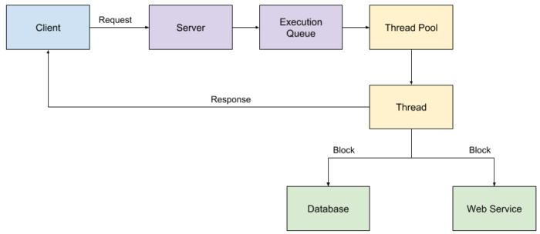
Traditional

Slide 129
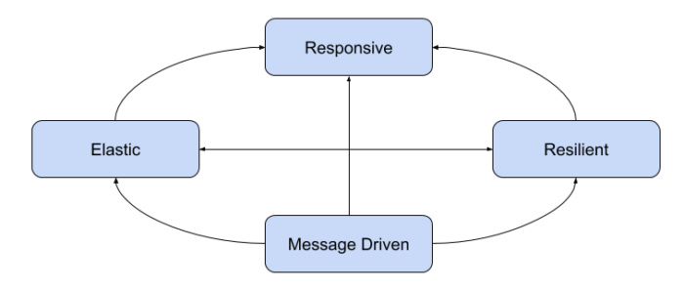
WebFlux

Slide 130
WebFlux
Reactive systems are responsive, meaning that they respond in a timely manner, in all possible circumstances. They focus on providing rapid and consistent response times, establishing reliable upper bounds so they deliver a consistent quality of service.

Slide 131
WebFlux
Reactive systems are resilient, meaning that they remain responsive in the face of failure. Resilience is achieved by the techniques of replication, containment, isolation, and delegation. By isolating application components from each other, you can contain failures and protect the system as a whole.

Slide 132
WebFlux
Reactive systems are elastic, meaning that they stay responsive under varying workloads. This is achieved by scaling application components elastically to meet the current demand.

Slide 133
WebFlux
Reactive systems are message-driven, meaning that they rely on asynchronous message passing between components. This allows you to create loose coupling, isolation, and location transparency.

Slide 134
Characteristics of a reactive system
Reactive systems are built by creating isolated components that communicate with one another asynchronously and can scale quickly to meet the current load. Components still fail in reactive systems, but there are defined actions to perform as a result of that failure, which keeps the system as a whole functional and responsive.

Slide 135
Characteristics of a reactive system
Data streams: A stream is a sequence of events ordered in time, such as user interactions, REST service calls, JMS messages, and results from a database.
Asynchronous: Data stream events are captured asynchronously and your code defines what to do when an event is emitted, when an error occurs, and when the stream of events has completed.

Slide 136
Characteristics of a reactive system
Non-blocking: As you process events, your code should not block and perform synchronous calls; instead, it should make asynchronous calls and respond as the results of those calls are returned.
Back pressure: Components control the number of events and how often they are emitted. In reactive terms, your component is referred to as the subscriber and events are emitted by a publisher. This is important because the subscriber is in control of how much data it receives and thus will not overburden itself.

Slide 137
Characteristics of a reactive system
Failure messages: Instead of components throwing exceptions, failures are sent as messages to a handler function. Whereas throwing exceptions breaks the stream, defining a function to handle failures as they occur does not.

Slide 138
The Reactive Streams API
The new Reactive Streams API was created by engineers from Netflix, Pivotal, Lightbend, RedHat, Twitter, and Oracle, among others. Published in 2015, the Reactive Streams API is now part of Java 9. It defines four interfaces:
Publisher: Emits a sequence of events to subscribers.
Subscriber: Receives and processes events emitted by a Publisher.
Subscription: Defines a one-to-one relationship between a Publisher and a Subscriber.
Processor: Represents a processing stage consisting of both a Subscriber and a Publisher and obeys the contracts of both.

Slide 139
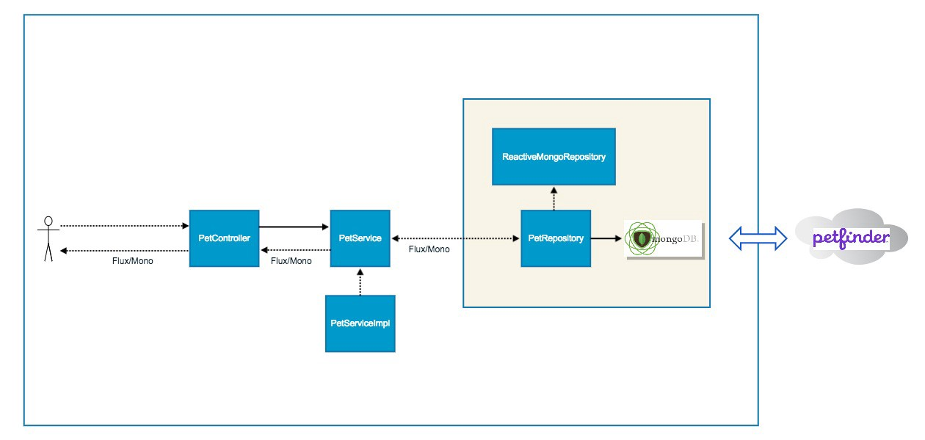

Slide 140
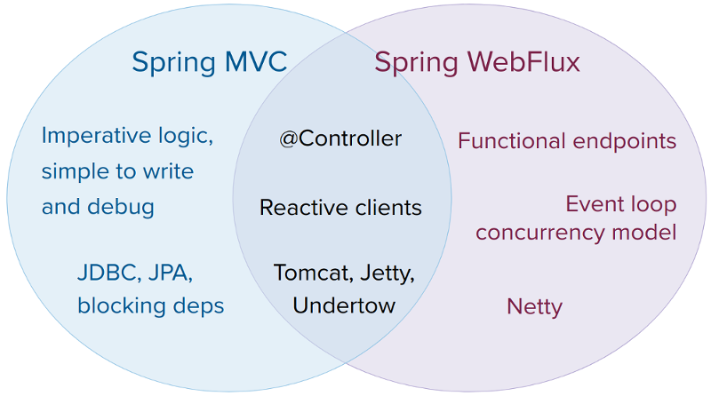
Spring MVC vs WebFlux

Slide 145
Why Streams?
In software development, there can be cases where we need to handle the potentially large amount of data.
So while handling these kinds of scenarios there can be issues such as `out of memory` exceptions so we should divide the data in chunks and handle the chunks independently.

Slide 146
What is the Akka Framework?
Akka is a toolkit and runtime for building highly concurrent, distributed, and fault tolerant applications on the JVM.
Akka is written in Scala, with language bindings provided for both Scala and Java.
Akka’s approach to handling concurrency is based on the Actor Model.
In an actor-based system, everything is an actor, in much the same way that everything is an object in object-oriented design.
A key difference is that the Actor Model was specifically designed and architected to serve as a concurrent model whereas the object-oriented model is not.
More specifically, in a Scala actor system, actors interact and share information, without any presupposition of sequentiality.
The mechanism by which actors share information with one another, and task one another, is message passing.

Slide 147
What is the Akka Framework?
Akka creates a layer between the actors and the underlying system such that actors simply need to process messages.
All the complexity of creating and scheduling threads, receiving and dispatching messages, and handling race conditions and synchronization, is relegated to the framework to handle transparently.

Slide 148
What is the Akka Framework?
Akka strictly adheres to the Reactive Manifesto.
Reactive applications aim at replacing traditional multithreaded applications with an architecture that satisfies one or more of the following requirements:
Event-driven. Using Actors, one can write code that handles requests asynchronously and employs non-blocking operations exclusively.
Scalable. In Akka, adding nodes without having to modify the code is possible, thanks both to message passing and location transparency.

Slide 149
What is the Akka Framework?
Resilient. Any application will encounter errors and fail at some point in time. Akka provides “supervision” (fault tolerance) strategies to facilitate a self-healing system.
Responsive. Many of today’s high performance and rapid response applications need to give quick feedback to the user and therefore need to react to events in an extremely timely manner. Akka’s non-blocking, message-based strategy helps achieve this.

Slide 150
What is an Actor in Akka?
An actor is essentially nothing more than an object that receives messages and takes actions to handle them.
It is decoupled from the source of the message and its only responsibility is to properly recognize the type of message it has received and take action accordingly.

Slide 151
What is an Actor in Akka?
Upon receiving a message, an actor may take one or more of the following actions:
Execute some operations itself (such as performing calculations, persisting data, calling an external web service, and so on)
Forward the message, or a derived message, to another actor
Instantiate a new actor and forward the message to it.
Alternatively, the actor may choose to ignore the message entirely (i.e., it may choose inaction) if it deems it appropriate to do so.

Slide 152
The Actor System
Taking a complex problem and recursively splitting it into smaller sub-problems is a sound problem solving technique in general.
This approach can be particularly beneficial in computer science (consistent with the Single Responsibility Principle), as it tends to yield clean, modularized code, with little or no redundancy, that is relatively easy to maintain.

Slide 153
The Actor System
In an actor-based design, use of this technique facilitates the logical organization of actors into a hierarchical structure known as an Actor System.
The actor system provides the infrastructure through which actors interact with one another.

Slide 154
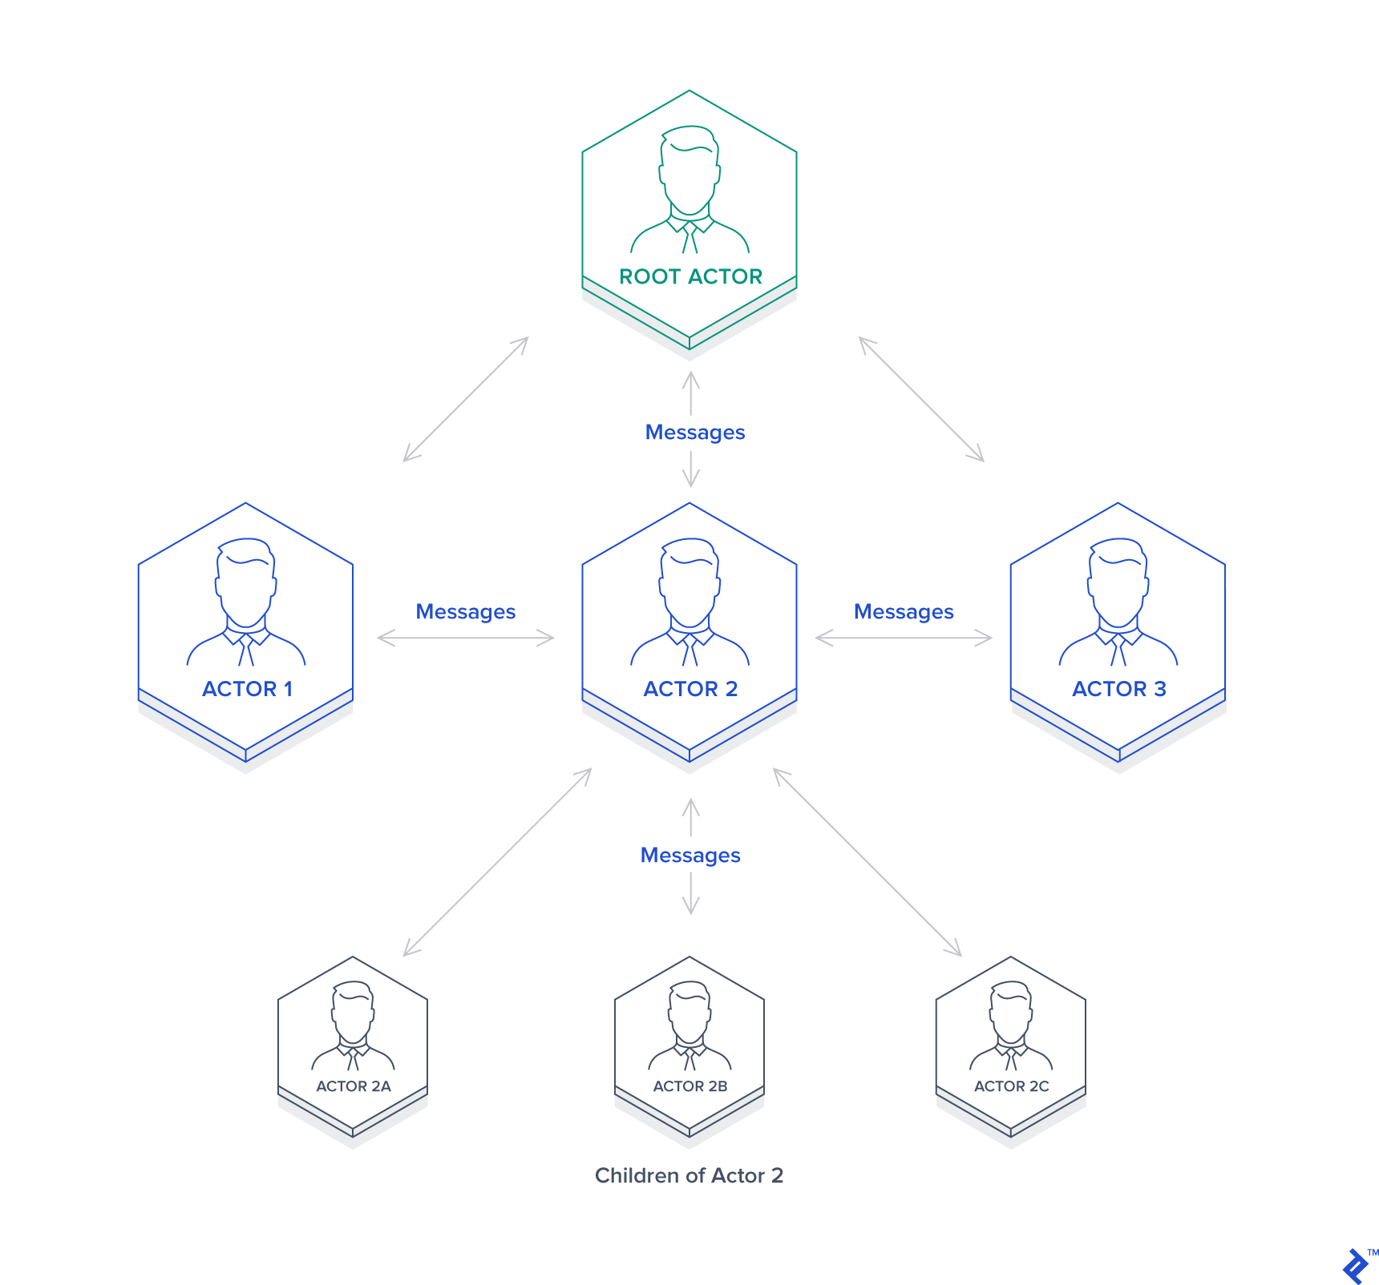
The Actor System

Slide 155
The Actor System
In Akka, the only way to communicate with an actor is through an ActorRef.
An ActorRef represents a reference to an actor that precludes other objects from directly accessing or manipulating that actor’s internals and state.
Messages may be sent to an actor via an ActorRef using one of the following syntax protocols:
! (“tell”) – sends the message and returns immediately
? (“ask”) – sends the message and returns a Future representing a possible reply

Slide 156
The Actor System
Each actor has a mailbox to which its incoming messages are delivered.
There are multiple mailbox implementations from which to choose, with the default implementation being FIFO.
An actor contains many instance variables to maintain state while processing multiple messages.
Akka ensures that each instance of an actor runs in its own lightweight thread and that messages are processed one at a time.
In this way, each actor’s state can be reliably maintained without the developer needing to explicitly worry about synchronization or race conditions.

Slide 157
The Actor System
Each actor is provided with the following useful information for performing its tasks via the Akka Actor API:
sender: an ActorRef to the sender of the message currently being processed
context: information and methods relating to the context within which the actor is running (includes, for example, an actorOf method for instantiating a new actor)
supervisionStrategy: defines the strategy to be used for recovering from errors
self: the ActorRef for the actor itself

Slide 158
Supervision
supervision describes a dependency relationship between actors: the supervisor delegates tasks to subordinates and therefore must respond to their failures.
When a subordinate detects a failure (i.e. throws an exception), it suspends itself and all its subordinates and sends a message to its supervisor, signaling failure.
Depending on the nature of the work to be supervised and the nature of the failure, the supervisor has a choice of the following four options:

Slide 159
Supervision
Resume the subordinate, keeping its accumulated internal state
Restart the subordinate, clearing out its accumulated internal state
Stop the subordinate permanently
Escalate the failure, thereby failing itself

Slide 160
What Restarting Means
When presented with an actor which failed while processing a certain message, causes for the failure fall into three categories:
Systematic (i.e. programming) error for the specific message received
(Transient) failure of some external resource used during processing the message
Corrupt internal state of the actor

Slide 161
What Restarting Means
suspend the actor (which means that it will not process normal messages until resumed), and recursively suspend all children
call the old instance’s preRestart hook (defaults to sending termination requests to all children and calling postStop)
wait for all children which were requested to terminate (using context.stop()) during preRestart to actually terminate; this—like all actor operations—is non-blocking, the termination notice from the last killed child will effect the progression to the next step
create new actor instance by invoking the originally provided factory again
invoke postRestart on the new instance (which by default also calls preStart)
send restart request to all children which were not killed in step 3; restarted children will follow the same process recursively, from step 2
resume the actor

Slide 162
The Actor System
Akka ensures that each instance of an actor runs in its own lightweight thread and that messages are processed one at a time.
In this way, each actor's state can be reliably maintained without the developer needing to explicitly worry about synchronization or race conditions.

Slide 163
Actor System
Actors are objects which encapsulate state and behavior, they communicate exclusively by exchanging messages which are placed into the recipient’s mailbox.
In a sense, actors are the most stringent form of object-oriented programming, but it serves better to view them as persons:
while modeling a solution with actors, envision a group of people and assign sub-tasks to them, arrange their functions into an organizational structure and think about how to escalate failure.
The result can then serve as a mental scaffolding for building the software implementation.

Slide 164
Akka System
An actor is a container for State, Behavior, a Mailbox, Child Actors and a Supervisor Strategy.
All of this is encapsulated behind an Actor Reference.
One noteworthy aspect is that actors have an explicit lifecycle, they are not automatically destroyed when no longer referenced;

Slide 165
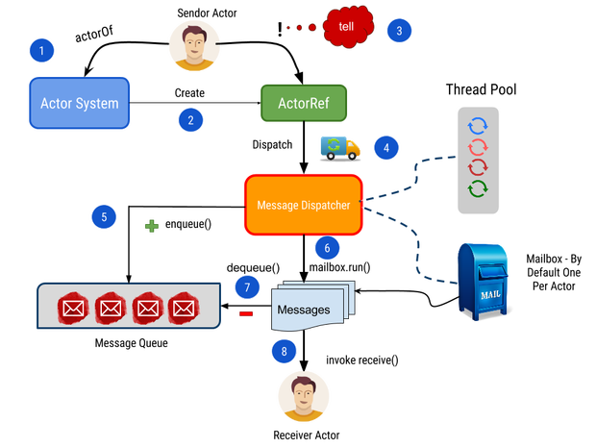

Slide 167
Akka System
State
Actor objects will typically contain some variables which reflect possible states the actor may be in.
This can be an explicit state machine, or it could be a counter, set of listeners, pending requests, etc.
These data are what make an actor valuable, and they must be protected from corruption by other actors.
The good news is that Akka actors conceptually each have their own light-weight thread, which is completely shielded from the rest of the system.
This means that instead of having to synchronize access using locks you can write your actor code without worrying about concurrency at all.

Slide 168
Akka System
Behavior
Every time a message is processed, it is matched against the current behavior of the actor.
Behavior means a function which defines the actions to be taken in reaction to the message at that point in time, say forward a request if the client is authorized, deny it otherwise.
This behavior may change over time, e.g. because different clients obtain authorization over time, or because the actor may go into an “out-of-service” mode and later come back.
These changes are achieved by either encoding them in state variables which are read from the behavior logic, or the function itself may be swapped out at runtime, see the become and unbecome operations.

Slide 169
Akka System
Mailbox
An actor’s purpose is the processing of messages, and these messages were sent to the actor from other actors (or from outside the actor system).
The piece which connects sender and receiver is the actor’s mailbox: each actor has exactly one mailbox to which all senders enqueue their messages.
Enqueuing happens in the time-order of send operations, which means that messages sent from different actors may not have a defined order at runtime due to the apparent randomness of distributing actors across threads.
Sending multiple messages to the same target from the same actor, on the other hand, will enqueue them in the same order.

Slide 170
Akka System
Child Actors
Each actor is potentially a supervisor: if it creates children for delegating sub-tasks, it will automatically supervise them.
The list of children is maintained within the actor’s context and the actor has access to it.
Modifications to the list are done by creating (context.actorOf(...)) or stopping (context.stop(child)) children and these actions are reflected immediately.
The actual creation and termination actions happen behind the scenes in an asynchronous way, so they do not “block” their supervisor.

Slide 171
Akka System
Supervisor Strategy
The final piece of an actor is its strategy for handling faults of its children.
Fault handling is then done transparently by Akka, applying one of the strategies in Supervision and Monitoring for each incoming failure.
As this strategy is fundamental to how an actor system is structured, it cannot be changed once an actor has been created.

Slide 172
Akka System
When an Actor Terminates
Once an actor terminates, i.e. fails in a way which is not handled by a restart, stops itself or is stopped by its supervisor, it will free up its resources, draining all remaining messages from its mailbox into the system’s “dead letter mailbox” which will forward them to the EventStream as DeadLetters.
The mailbox is then replaced within the actor reference with a system mailbox, redirecting all new messages to the EventStream as DeadLetters.
This is done on a best effort basis, though, so do not rely on it in order to construct “guaranteed delivery”.

Slide 173
Akka System
Akka is a set of open-source libraries for designing scalable, resilient systems that span processor cores and networks.
Akka allows you to focus on meeting business needs instead of writing low-level code to provide reliable behavior, fault tolerance, and high performance.
Many common practices and accepted programming models do not address important challenges inherent in designing systems for modern computer architectures.

Slide 174
Akka System
To be successful, distributed systems must cope in an environment where components crash without responding, messages get lost without a trace on the wire, and network latency fluctuates.

Slide 175
Akka System
Akka provides:
Multi-threaded behavior without the use of low-level concurrency constructs like atomics or locks — relieving you from even thinking about memory visibility issues.
Transparent remote communication between systems and their components — relieving you from writing and maintaining difficult networking code.
A clustered, high-availability architecture that is elastic, scales in or out, on demand — enabling you to deliver a truly reactive system.

Slide 176
Akka Streams
Akka-Streams provide a higher-level abstraction over Akka’s existing actor model.
The Actor model provides an excellent primitive for writing concurrent, scalable software, but it still is a primitive;

Slide 177
Akka Streams basics
In Akka Streams, we represent data processing in a form of data flow through an arbitrary complex graph of processing stages.
Stages have zero or more inputs and zero or more outputs.
The basic building blocks are Sources (one output), Sinks (one input) and Flows (one input and one output).
Using them, we can build arbitrary long linear pipelines.

Slide 178
Akka Streams basics
Akka streams consist of 3 major components in it – Source, Flow, Sink – and any non-cyclical stream consist of at least 2 components Source, Sink and any number of Flow element.
Source – this is the Source of data. It has exactly one output. We can think of Source as Publisher.
Sink – this is the Receiver of data. It has exactly one input. We can think of Sink as Receiver.
Flow – this is the Transformation that acts on the Source. It has exactly one input and one output.

Slide 179
Akka Streams basics

Slide 180
What are Reactive Streams?
Applications developed using streams can run into problems if Source is generating data too fast than the Sink can handle.
This causes Sink to buffer the data – but the problem is if data is too large then Sink buffer will also grow and can lead to memory issues.
So to handle this Sink need to communicate with the Source – to slow down the generation of data until it finished handling of current data.
This handle of communication between Publisher and Receiver is called as Backpressure handling. And Streams that handle this mechanism are called Reactive Streams.
Example using Akka Stream:

Slide 181
What are Reactive Streams?
MATERIALIZER
A materializer is optional in Akka-streams
We can use one if we want our Flow to have some side effects like logging or saving results.
However, we can pass NotUsed alias as a Materializer to denote that our Flow should not have any side effects

Slide 182
What are Reactive Streams?
RUNNABLE GRAPH
A graph is a whole set of Outlet/FlowShape/Inlet linked together, that is closed.
After a stream is properly terminated by having both a source and a sink, it will be represented by the Runnable Graph type, indicating that it is ready to be executed.

Slide 183
BroadCasting In Akka Streams
One of the most straightforward ways to partition a stream is to simply broadcast every upstream element to a set of downstream Akka Streams: Streaming Live consumers.
Every downstream consumer will receive exactly the same stream of messages and can independently apply filtering, transformations, aggregations, or side-effects.
Basically, Broadcast ingests events from one input and emits duplicated events across more than one output stream.

Slide 184
What shall users of Akka Streams expect?
Akka is built upon a conscious decision to offer APIs that are minimal and consistent—as opposed to easy or intuitive.
Akka Streams:
all features are explicit in the API, no magic
supreme compositionality: combined pieces retain the function of each part
exhaustive model of the domain of distributed bounded stream processing

Slide 185
What shall users of Akka Streams expect?
This means that we provide all the tools necessary to express any stream processing topology, that we model all the essential aspects of this domain (back-pressure, buffering, transformations, failure recovery, etc.) and that whatever the user builds is reusable in a larger context.

Slide 186
Use Case
Let’s say we have a directory that we want to watch for new CSV files, then process every file in a streaming fashion, perform some on-the-fly aggregations and send the aggregated results to a websocket (in real time).
Additionally, we want to define some kind of threshold for the aggregated data to trigger email notifications.
In our case the CSV lines will contain some (id, value) pairs, with the id changing every second line, e.g.:
370582,0.17870700247256666
370582,0.5262255382633264
441876,0.30998025265909457
441876,0.3141591265785087
722246,0.7334219632071504
722246,0.5310146239777006

Slide 187
Use Case
We want to compute an average value of every two lines sharing the same id and only send it to the websocket when it’s greater than 0.9.
Moreover, we want to send a notification email on every 5th value sent to the websocket.
Finally, we want to read and display the data received from the websocket with a trivial JavaScript frontend.

Slide 188

The architecture

Slide 189
The architecture
The core will of course be Akka Streams, which lets us process the data in real time and in a streaming fashion.
To read the CSV files, we’re going to use Alpakka, which is a set of Akka Streams connectors to various technologies, protocols or libraries.
Since Akka Streams are Reactive Streams, the entire Alpakka ecosystem is also accessible to any other RS implementation - this is the benefit of interoperability that the RS interfaces set out to achieve.
Finally, we’re going to use Akka HTTP to expose a websocket endpoint.
The nice thing here is that Akka HTTP seamlessly integrates with Akka Streams (which it actually uses under the hood), so exposing a stream as a websocket is trivial.

Slide 190
Pros and Cons Of Using Akka Streams
Pros :
Akka streams implement something called reactive manifesto which is great to achieve really low latency.
Akka streams provide a lot of operators to write declaratively transformations over streams easily.
One of the best approach to use when working with a real-time or reactive category.
In case you have more of custom needs such as running a ton of varying jobs with different actors/flows, then Akka streams can help you in that.
Akka streams are quite economical in some cases when it comes to threads.

Slide 191
Pros and Cons Of Using Akka Streams
Cons:
Using Akka streams imposes some overhead in getting up and running. It requires learning the DSL and also understanding what’s going on under the hood to some extent.
Implementation hard to read
Conceptually very complicated
Unlike heavier “streaming data processing” frameworks, Akka Streams are not “deployed” nor automatically distributed.

Slide 192
Kotlin
Kotlin is a general-purpose, statically typed, and open-source programming language.
It runs on JVM and can be used anywhere Java is used today. It can be used to develop Android apps, server-side apps and much more.

Slide 193
Kotlin
History of Kotlin
Kotlin was developed by JetBrains team. A project was started in 2010 to develop the language and officially, first released in February 2016. Kotlin was developed under the Apache 2.0 license.

Slide 194
Kotlin
Features of Kotlin
Concise: Kotlin reduces writing the extra codes. This makes Kotlin more concise.
Null safety: Kotlin is null safety language. Kotlin aimed to eliminate the NullPointerException (null reference) from the code.Interoperable.
Interoperable: Kotlin easily calls the Java code in a natural way as well as Kotlin code can be used by Java.
Smart cast: It explicitly typecasts the immutable values and inserts the value in its safe cast automatically.
Compilation Time: It has better performance and fast compilation time.
Tool-friendly: Kotlin programs are build using the command line as well as any of Java IDE.
Extension function: Kotlin supports extension functions and extension properties which means it helps to extend the functionality of classes without touching their code.

Slide 195
Using Kotlin for Server-side Development
Expressiveness: Kotlin's innovative language features, such as its support for type-safe builders and delegated properties, help build powerful and easy-to-use abstractions.
Scalability: Kotlin's support for coroutines helps build server-side applications that scale to massive numbers of clients with modest hardware requirements.
Interoperability: Kotlin is fully compatible with all Java-based frameworks, which lets you stay on your familiar technology stack while reaping the benefits of a more modern language.
Migration: Kotlin supports gradual, step by step migration of large codebases from Java to Kotlin. You can start writing new code in Kotlin while keeping older parts of your system in Java.

Slide 196
Using Kotlin for Server-side Development
Tooling: In addition to great IDE support in general, Kotlin offers framework-specific tooling (for example, for Spring) in the plugin for IntelliJ IDEA Ultimate.
Learning Curve: For a Java developer, getting started with Kotlin is very easy. The automated Java to Kotlin converter included in the Kotlin plugin helps with the first steps.
Kotlin Koans offer a guide through the key features of the language with a series of interactive exercises.

Slide 197
Kotlin Data Type
In Kotlin, everything is an object, which means we can call member function and properties on any variable.
Kotlin built in data type are categorized as following different categories:
Number
Character
Boolean
Array
String

Slide 198
Questions

Slide 199
Module Summary
Spring Integration Framework.
Message, Channel and Adapter
Understood the different Component Integration
Understood the Event-Driven Architecture

